Slide 1

Grazing on Small Acreages in the Big Horn Basin
Ted Smith
University of Wyoming Extension Horticulture Program Coordinator
Northwest College Range Management
Associate Degree 2025
307-527-8560 tsmit144@uwyo.edu

Slide 2
Introduction
How much forage/nutrition does my land provide?
What are my expectations and ultimate outcomes?
What animals do I want and their numbers?
Do I have pasture or just rangeland?
How do I maximize my land?
Will my grazing land be the major source of my animal's nutrition or will it be hay?

Slide 3
Let’s start with some basic terms
Animal behavior-all the ways animals interact with other organisms and the physical environment
Animal Unit (AU)-one mature cow (#1000) with calf or their equivalent of forage consumption in dry matter (26 pounds) per day
Biomass-the total weight or quantity of living plant material (forage) within a given area or ecosystem
Browse- tender shoots, twigs, and leaves of trees and shrubs
Crown-the conduit from where the energy flow occurs between the roots and the shoots, usually at the soil surface
Dry Matter-the amount of a feedstuff remaining after all the free moisture is evaporated out
Forbs-a herbaceous flowering plant that is not a grass- typically short plants with long, narrow leaves, growing wild or cultivated on lawns and pasture, and as a fodder crop
Grass- any of a large family ( Gramineae or Poaceae ) of monocotyledonous plants having narrow leaves, hollow stems : Cool Season (spring and fall growth) and Warm Season (summer growth)
Grazing- allowing livestock to directly consume the growing forage; grasses, legumes, and forbs, in a pasture or rangeland
Legumes-plants with flowers like the sweet pea and produce their seeds in pods (alfalfa, clover, peas)
Roots-the underground part of a plant, vital for water and nutrient uptake
Rotation- the practice of moving livestock between different pastures or paddocks in a planned sequence to allow for pasture recovery and growth, improving soil health, and maximizing forage utilization
Shrubs- low-growing woody plants

Slide 4
Animal species consumption per day in dry matter
Class of Animal | Animal Unit Equivalents | Pounds of Dry Matter Daily
Cow, 1000 lb. with or without a calf | 1.00 | 26
Bulls, 2 years and over | 1.50 | 39
Yearling heifers and steers | 0.67 | 17.4
Weaned calves | 0.50 | 13
Horse, 2-year-old | 1.00 | 26
Horse, 3 years old and over | 1.25 | 32.5
Horse, yearlings | 0.75 | 19.5
Ewe with or without lambs | 0.20 | 5.2
Doe with or without kids | 0.15 | 4.7
Ram or buck | 0.26 | 6.8
Weaned lamb or kid, up to 12 months | 0.10 | 2.6
Jackrabbit | 0.02 | 0.05
Antelope | 0.20 | 5.2
Mule deer | 0.20 | 5.2
White-tail deer | 0.20 | 5.2

Slide 5
Animal species consumption per day in water
Water requirements vary for animals depending on the species, weather and climate
  Sheep: 1-1 ½ gallons once/2 days
  Goat: 1-1 ½ gallons once/2 days
  Donkeys: 3-4 gallons once/day
  Horses: 5-8 gallons once or twice/day
  Cattle and Bison: 8-10 gallons once/1-2 days

Slide 6
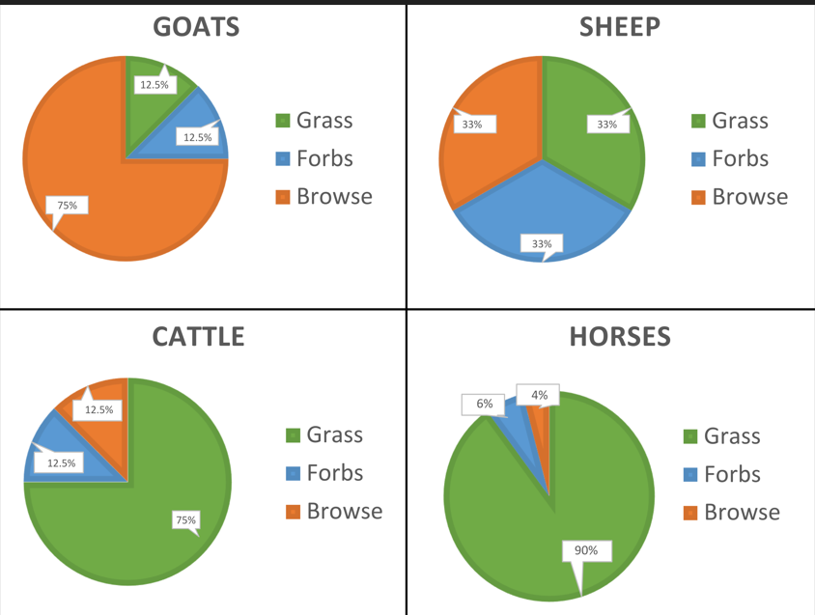
Diet preferences

Slide 7
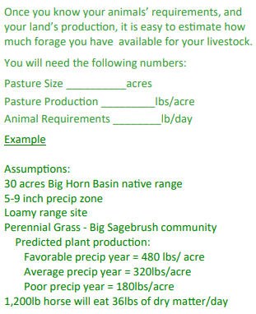
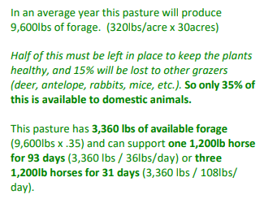
Calculate your stocking rate in rangeland

Slide 8
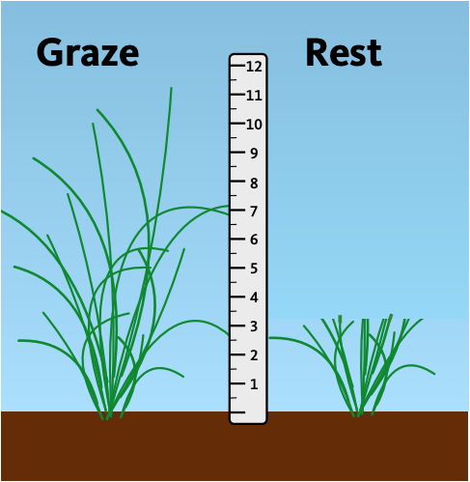
Grazing’s Rule of Thumb
Take Half,
Leave Half

Slide 9
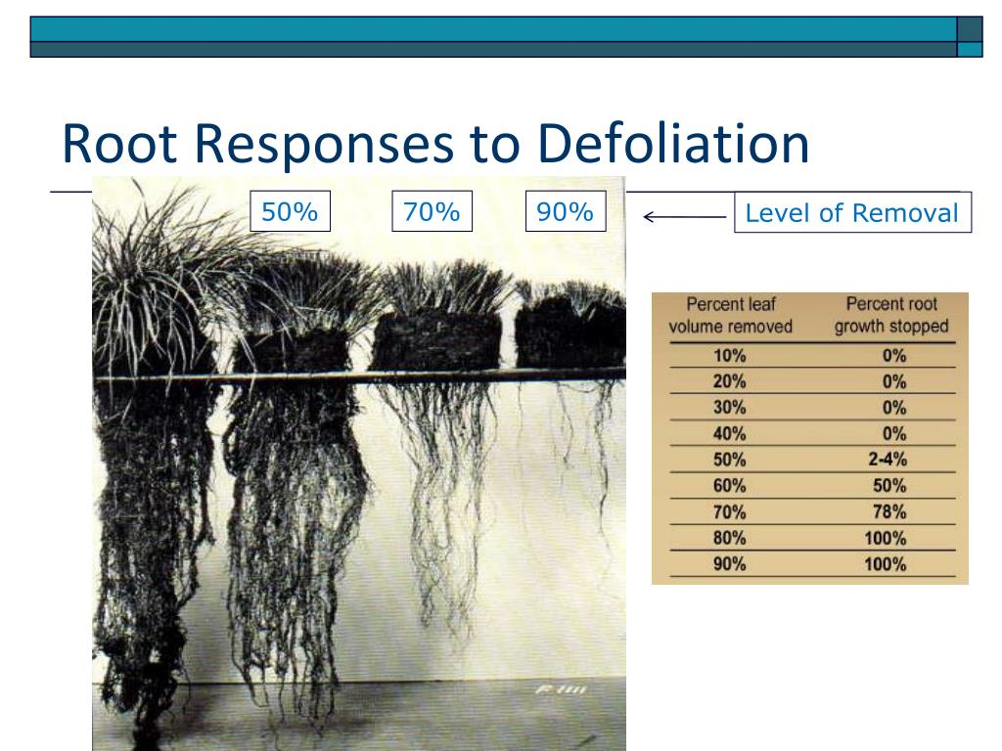
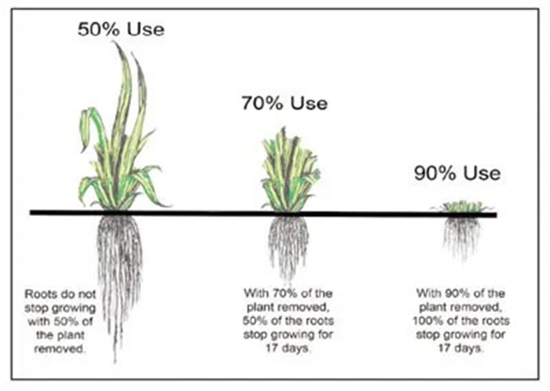
Removal and Recovery of Biomass and Roots

Slide 10
What Do You Have?
A.) Pasture B.) Rangeland
C.) Level or Flat D.) Rolling or Steep-slopes
What is your primary source of water?
A.) Seasonal Rainfall B.) Irrigation
What grazing strategy suits your forage output and labor availability?
A.) Continuous grazing
B.) Rotational grazing
C.) Intensive rotational grazing
D.) Multi species grazing

Slide 11
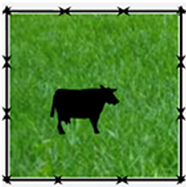
Continuous Grazing
• Continuous Grazing: one-pasture system that allows livestock to continually graze one large section of land

Slide 12
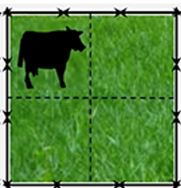
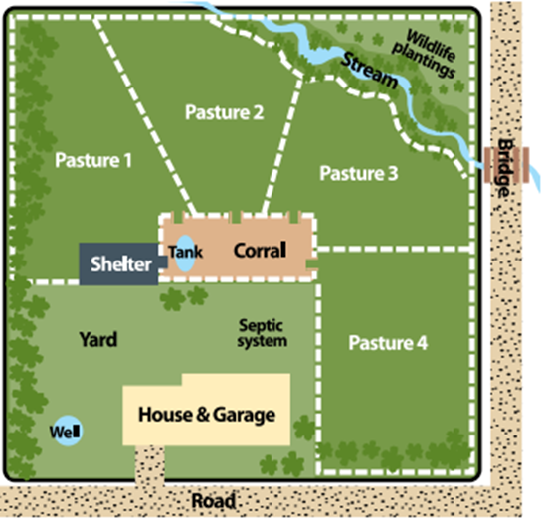
Rotational Grazing
Rotational Grazing: uses more than one pasture and rotates cattle from one pasture to the next at varying intervals

Slide 13
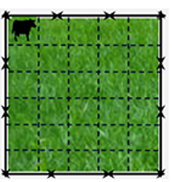
Intensive Rotational Grazing
• Intensive Rotational Grazing: rotation between pastures frequently allowing for pasture regrowth

Slide 14
Multi Species Grazing
Multi-species grazing is when more than one kind of livestock graze a unit of land
Grazing can occur at the same time or at different times
Multi-species grazing is the norm for naturally regulated ecosystems by a variety of herbivores
Increased carrying capacity
Suppression of undesirable weeds
Improved animal health- parasite problems are often reduced

Slide 15
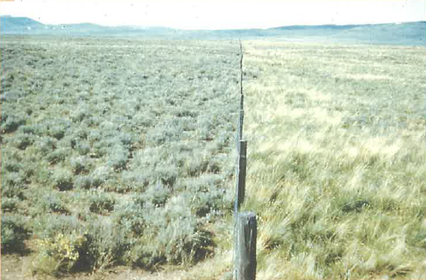
Beef Grazing vs. Multi-Species Grazing Over Decades

Slide 16
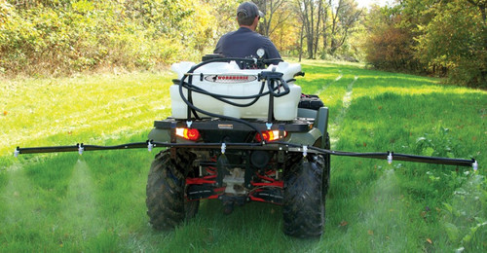
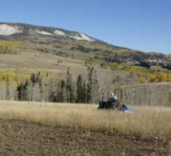
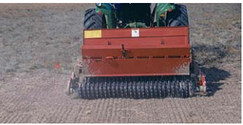
Pasture Renovation
The first step to renovate a pasture is reducing competition
Before planting, seedbeds should ideally be firm, moist, free of weeds, and free of debris
Because most forage species have small seeds, they require precise and fairly shallow placement in the seedbed. This is best accomplished with a drill.

Slide 17
Concluding Thoughts
Water is the limiting factor for livestock production in Wyoming
Pastures produces more forage than rangeland
Both pastures and rangelands must be managed
Know your lands productivity and stocking capacity
Select the best management practice for your land, animals, and lifestyle
You are not alone, UW Extension along with ag businesses in the area are here to advise and assist you
Supplemental forage and grain is needed for animal nutrition and health in our area

Slide 18
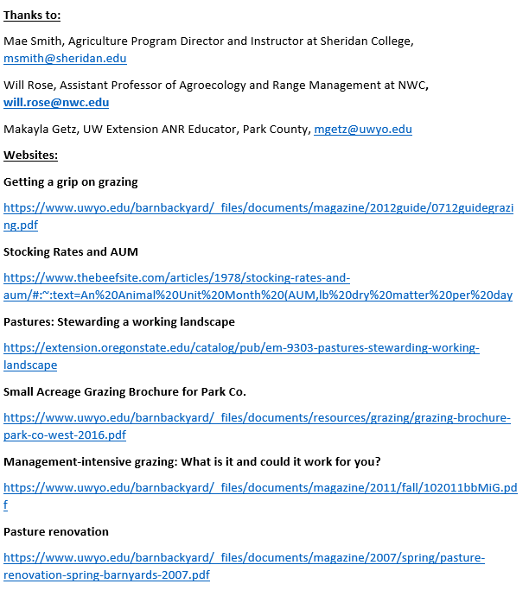
Resources and References

Slide 19

Thank you for your time
Ted Smith
University of Wyoming Extension
Horticulture Program Coordinator
307-527-8560 tsmit144@uwyo.edu
Ted.Smith@parkcounty-wy.gov
Makayla Getz
Agriculture and Natural Resources (ANR) Educator
(307) 754-8836 | mgetz@uwyo.edu

