Slide 1
Web Soil Survey
  http://websoilsurvey.sc.egov.usda.gov/App/WebSoilSurvey.aspx
  Or Google Web Soil Survey

Slide 2
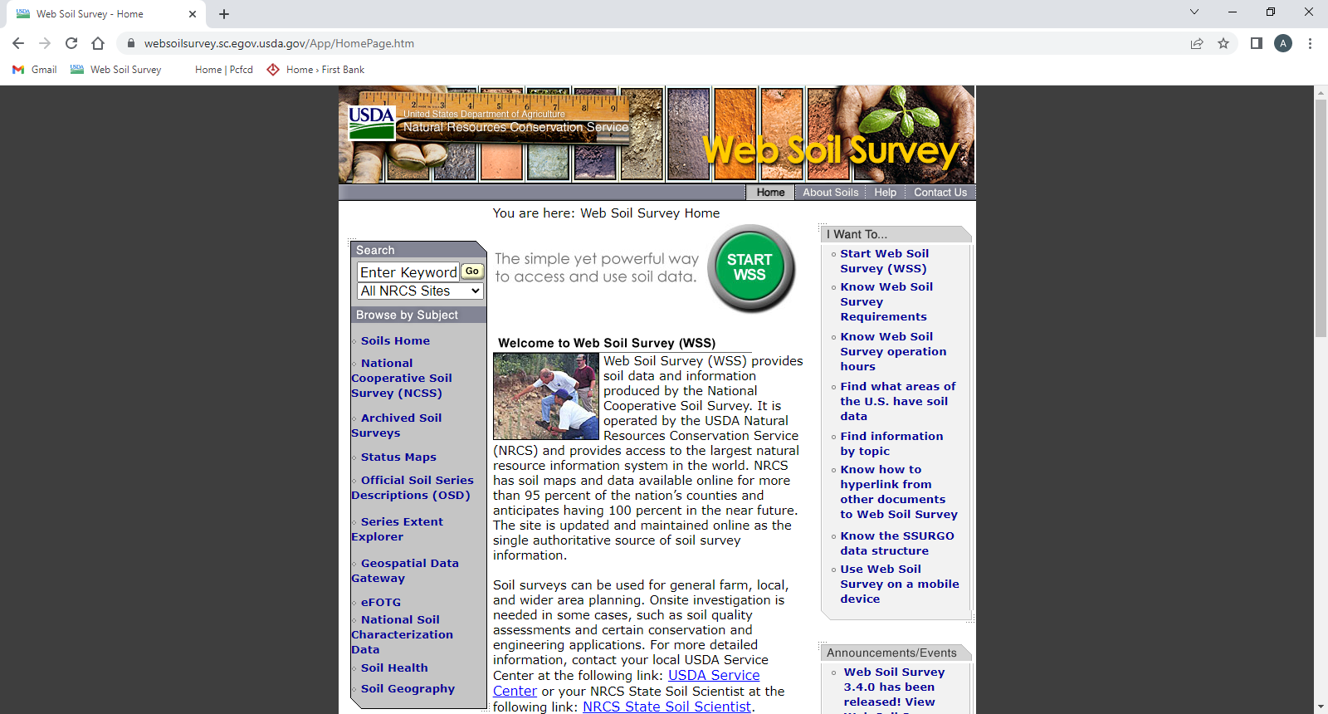
Home page
Click on Start Web Soil Survey to launch

Slide 3
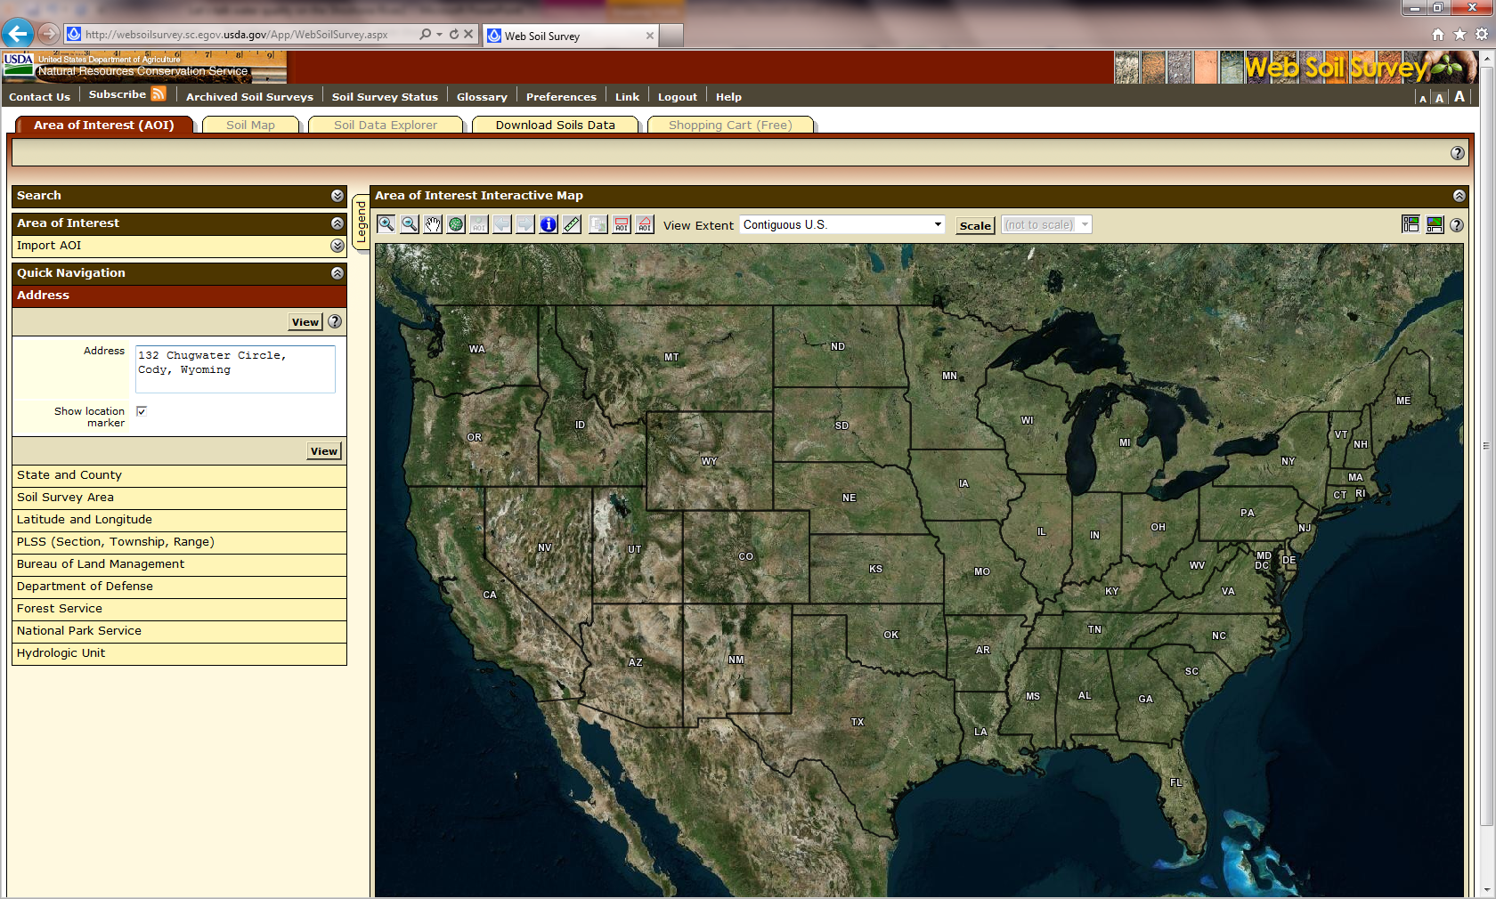
Web Soil Survey – Use your address to start search

Slide 4
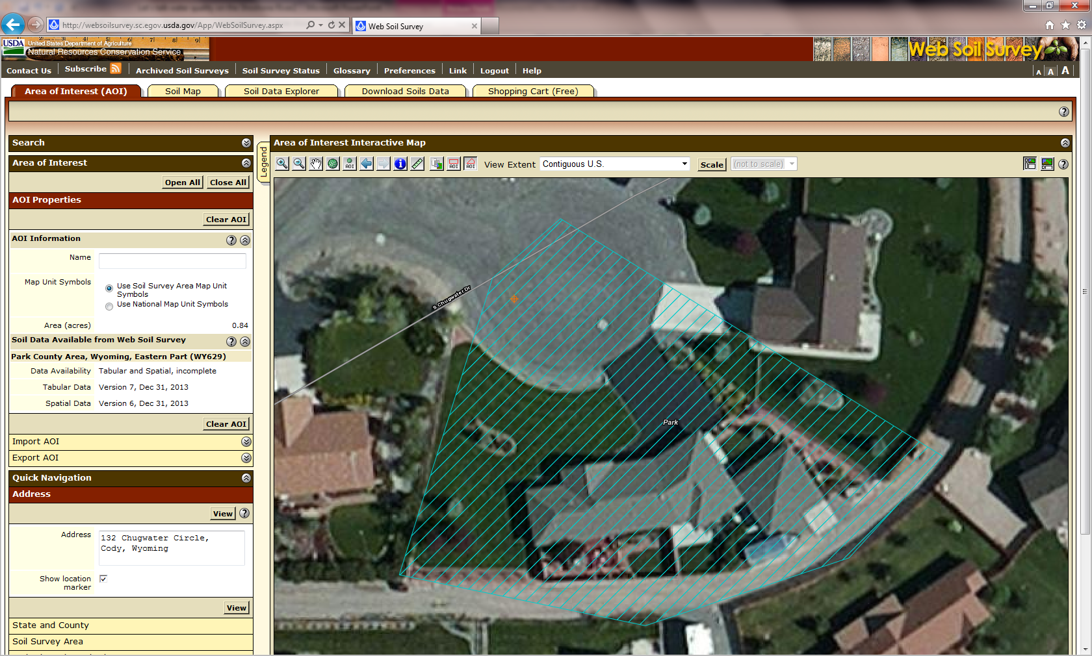
Web Soil Survey – Area of Interest

Slide 5
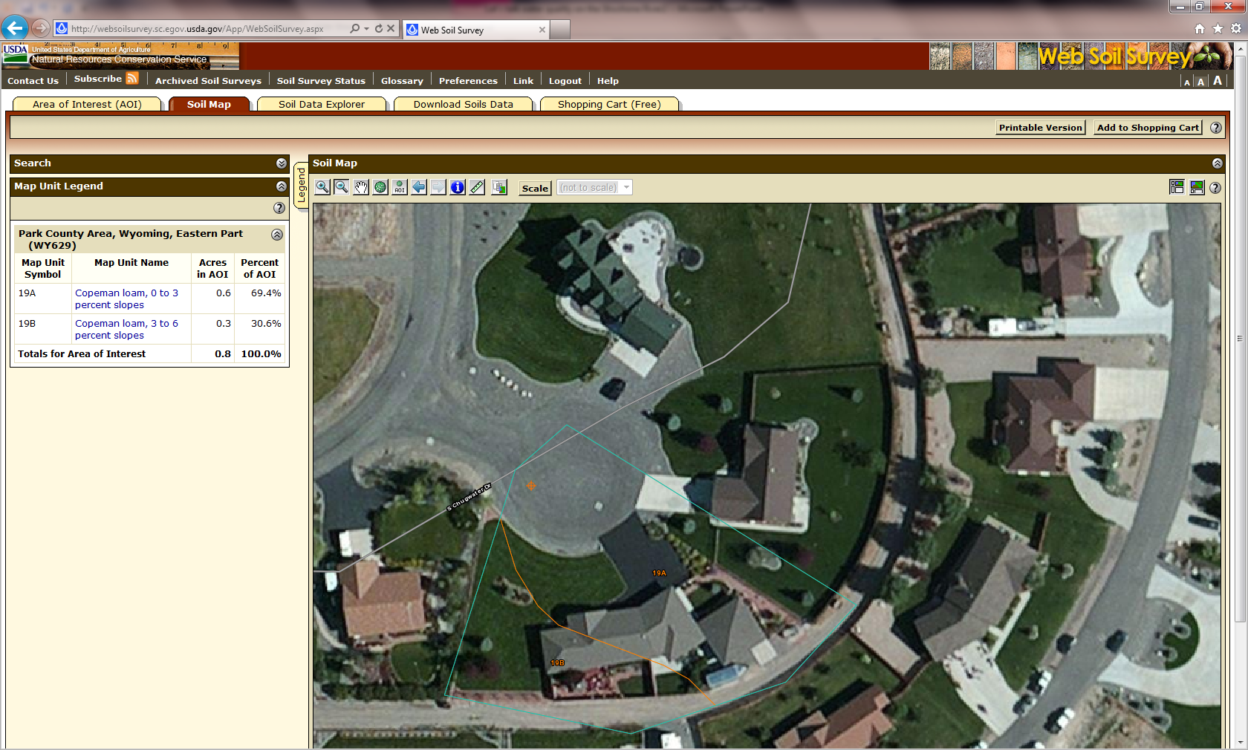
Web Soil Survey – Soil Map

Slide 6
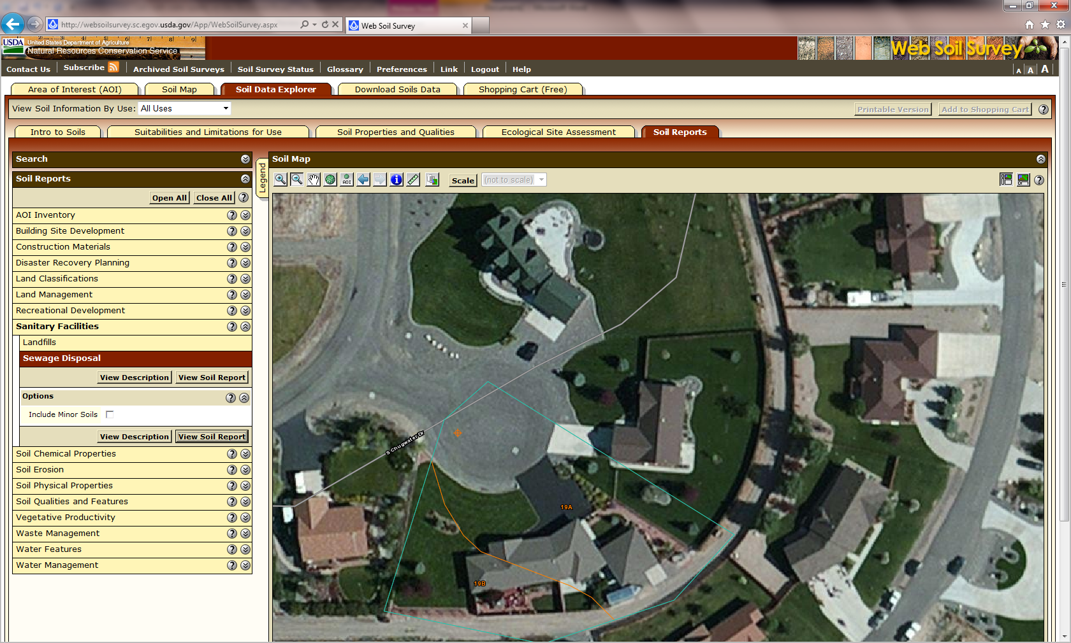
Web Soil Survey – Soil Data Explorer/Soil Reports

Slide 7
Soil Reports Commonly Used
  Sewage Disposal
Map symbol and soil name | Pct. of map unit | Septic tank absorption fields |  | Sewage lagoons
 |  | Rating class and limiting features | Value | Rating class and limiting features | Value
19A—Copeman loam, 0 to 3 percent slopes — Draft
Copeman | 80 | Somewhat limited |  | Very limited
 |  | Slow water movement | 0.47 | Seepage | 1.00
19B—Copeman loam, 3 to 6 percent slopes — Draft
Copeman | 85 | Somewhat limited |  | Very limited
 |  | Slow water movement | 0.47 | Seepage | 1.00
 |  |  |  | Slope | 0.68

Slide 8
Building Site Development
  Dwellings and Small Commercial BuildingsDwellings and Small Commercial Buildings
Collapse Park County Area, Wyoming, Eastern PartPark County Area, Wyoming, Eastern Part
Map symbol and soil name | Pct. of map unit | Dwellings without basements |  | Dwellings with basements |  | Small commercial buildings
 |  | Rating class and limiting features | Value | Rating class and limiting features | Value | Rating class and limiting features | Value
19A—Copeman loam, 0 to 3 percent slopes — Draft
Copeman | 80 | Somewhat limited |  | Somewhat limited |  | Somewhat limited
 |  | Shrink-swell | 0.50 | Shrink-swell | 0.03 | Shrink-swell | 0.50
19B—Copeman loam, 3 to 6 percent slopes — Draft
Copeman | 85 | Somewhat limited |  | Somewhat limited |  | Somewhat limited
 |  | Shrink-swell | 0.50 | Shrink-swell | 0.03 | Shrink-swell | 0.50
 |  |  |  |  |  | Slope | 0

Slide 9
Land Classifications
  Prime and other important farmlands
Park County Area, Wyoming, Eastern Part
Map Symbol | Map Unit Name | Farmland Classification
19A | Copeman loam, 0 to 3 percent slopes — Draft | Farmland of statewide importance, if irrigated
19B | Copeman loam, 3 to 6 percent slopes — Draft | Farmland of statewide importance, if irrigated

Slide 10
Soil Erosion
Collapse Park County Area, Wyoming, Eastern PartPark County Area, Wyoming, Eastern Part
Map symbol and soil name | Pct. of map unit | Slope length (ft) | Hydrologic group | Kf | T factor | Representative value
 |  |  |  |  |  | % Sand | % Silt | % Clay
19A—Copeman loam, 0 to 3 percent slopes — Draft
Copeman | 80 | — | B | .24 | 4 | 40.0 | 34.0 | 26.0
19B—Copeman loam, 3 to 6 percent slopes — Draft
Copeman | 85 | — | B | .24 | 4 | 40.0 | 34.0 | 26.0
Soil properties and interpretations for erosion runoff calculations.

Slide 11
Local Roads and Streets
Map unit symbol | Map unit name | Rating | Component name (percent) | Rating reasons (numeric values) | Acres in AOI | Percent of AOI
19A | Copeman loam, 0 to 3 percent slopes — Draft | Somewhat limited | Copeman (80%) | Frost action (0.50) | 0.7 | 63.0%
 |  |  |  | Shrink-swell (0.50)
 |  |  |  | Low strength (0.02)
 |  |  | Zigweid (5%) | Frost action (0.50)
 |  |  |  | Shrink-swell (0.50)
 |  |  |  | Low strength (0.15)
19B | Copeman loam, 3 to 6 percent slopes — Draft | Somewhat limited | Copeman (85%) | Frost action (0.50) | 0.4 | 37.0%
 |  |  |  | Shrink-swell (0.50)
 |  |  |  | Low strength (0.02)
 |  |  | Zigweid (4%) | Frost action (0.50)
 |  |  |  | Shrink-swell (0.50)
 |  |  |  | Low strength (0.15)
Totals for Area of Interest |  |  |  |  | 1.2 | 100.0

Slide 12
Additional topics covered in review letter
  Irrigation management plan
  developed by appropriate irrigation district
  Weed management plan
  developed by Park County Weed and Pest
  Where appropriate – Wildlife management plan
  developed by Wyoming Game and Fish

