Slide 1
Living on a Few Acres Workshop
Austen Samet-Brown
Crop Advisor
Big Horn Co-op
Notes:
Hello, my name is Austen Samet-Brown
I got my Bachler's in Crop and Soil Science and Geology from Oregon State University. I graduated in 2011, commissioned into the United States Army as a chemical officer and moved to Wyoming. I immediately got a job working at the Big Horn Co-op Fertilizer plant. I worked a few sessions there in the office then decide to go back to school in 2015. I graduated from University of Wyoming in 2017 with my masters in Agronomy. Since then and now I have worked as a research assistant at the Powell Research and Extension Center and in their Analytical Seed Lab. I worked a few years as a field representative for Treasure Valley Seed Company and I am currently working as a crop advisor for the Big Horn Co-op. I am also currently a CPT in the Army Reserves and serving as a company commander for a unit in Billings. This will be my 6th year as a field rep and crop advisor, but I have been working in the agriculture industry for the past 14 years.

Slide 2

Co-op Overview
1923 Dry Beans, Yellow Blossom Clover and Turkeys
Agronomy locations in Powell, Basin and Riverton.
Fertilizer, Chemical and Seed.
Locally owned by the patrons.
Notes:
The Big horn Co-op was established in March of 1923. Farmers in the Big Horn Basin joined together to form a cooperative to market dry edible beans, yellow blossom clover, and turkeys. We have been operating in Wyoming for over 100 years. The Agronomy Division is doing well and still going strong, serving the locals and farmers in the Big Horn Basin and greater Wyoming area.
We have three fertilizer facilities, one in Powell, Basin and Riverton with our main office based out of Greybull.
We can provide agronomy services and can take care of nearly all your agricultural needs. We have fertilizer, liquid and dry, we carry chemicals to help with your weed and pest management and we carry many different options for seed, from many different varieties of hay seed to corn seed. You can also get fuel and propane from the coop. The Powell location has a tire shop, Worland has a nice C-store and Riverton has a thriving farm store.
Everyone here in this room can be a part owner of the co-op, everyone that makes a purchase from the Big Horn Co-op, owns a portion of the co-op.

Slide 3
What do I plant?
1. Do I have water to irrigate my land?
  Sprinkler, Gated Pipe, Siphon Tubes
2. What will be the purpose of the crop I want to grow?
  Horse/Cow Pasture, Alfalfa Hay, Grass Hay, Large Lawn
Notes:
So, lets jump right into the reason you all are here today!
You have some land, and you want to plant something but you're not sure what to plant or where to even start…. Or maybe you have something out in your field already but not sure what it is or how to properly manage it. Or maybe its not what you want to be out there.
You should start by asking yourself a few simple questions.
Do I have water? Can I irrigate my land or is it dry land? If I do have water, how do I irrigate?
The main form of irrigation in this area is called flood irrigation which utilizes gated pipe, ditches with dams and siphon tubes.
The other form of irrigation is with a sprinkler, either a center pivot sprinkler, wheel line, or hand line sprinkler if you have a smaller area.
What will be the purpose of the crop I want to grow?
Do I want to hay it or do I want pasture for my animals or do I just want something growing to help manage the weeds?

Slide 4
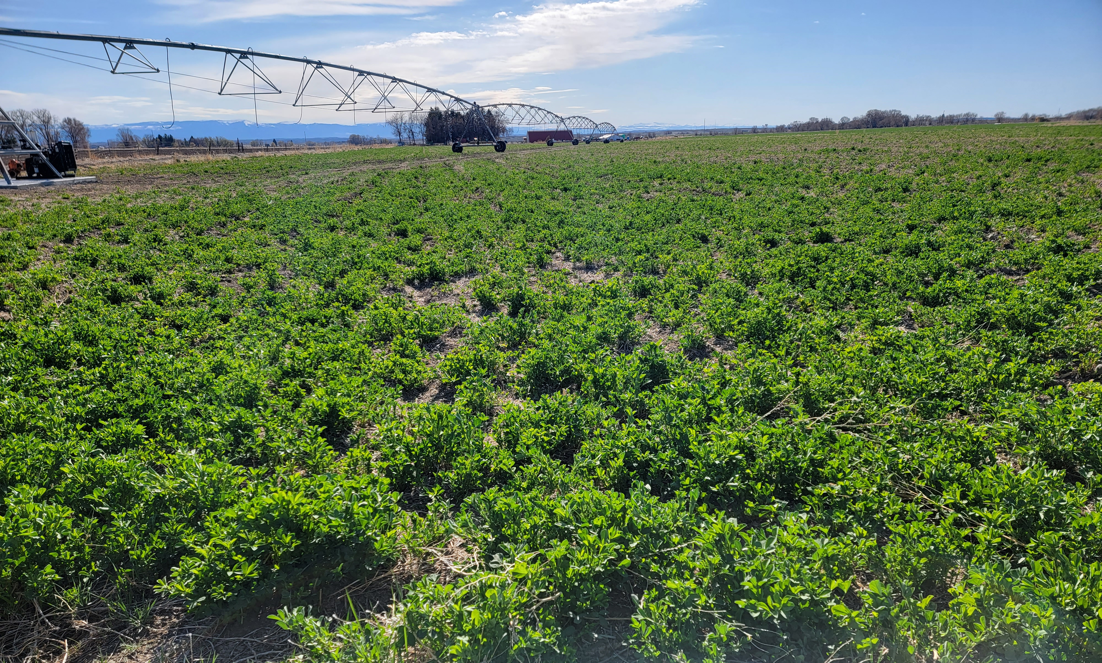
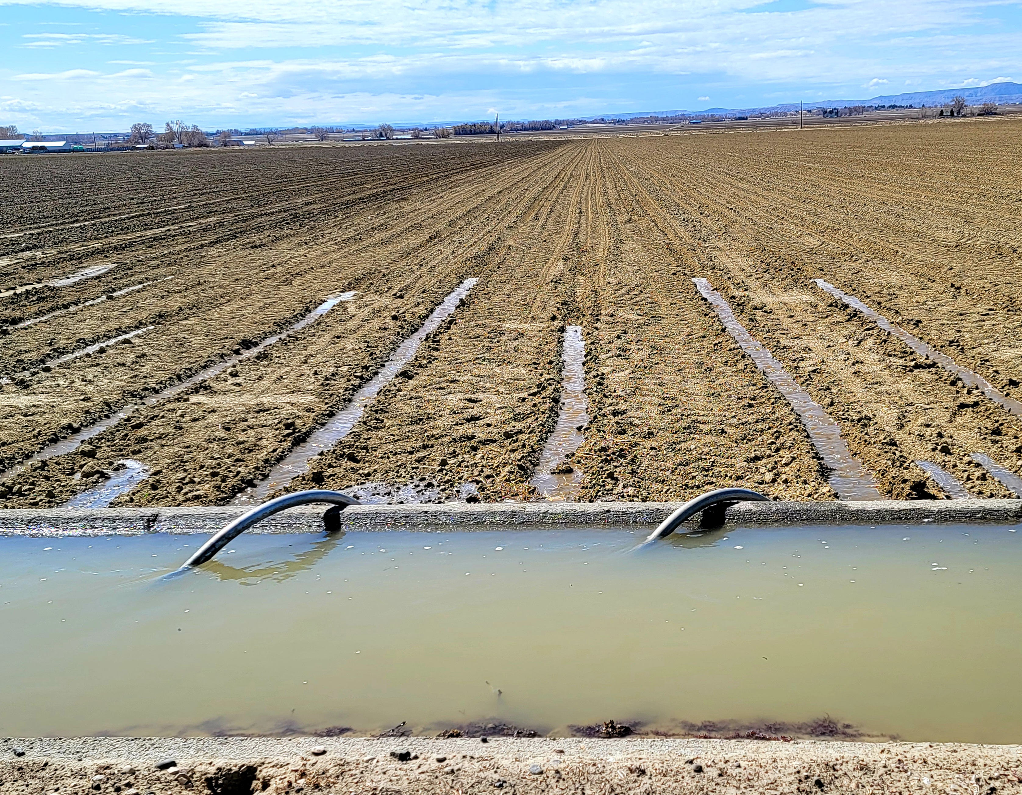
Notes:
So, once you determine if you have water or not, and how you are going to water your field.
And you have also determined what your goals are for your field regarding its purpose and your intended use.
Now you need to determine what you want to plant and how to plant it.
Or again maybe it is already planted but the field needs some attention and some better management practices to reach your intended goal.

Slide 5
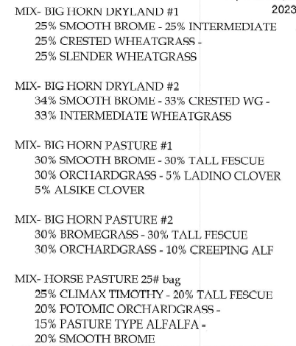
Pasture Options
Notes:
So, to start let's talk about these pasture blends that we offer. The ones listed on the slide are all great blends and can be used to thicken up an already established field or can be planted on a clean freshly worked and prepared field.
We offer blends that are completely grass mixes and blends that have a little clover or alfalfa in it. Blends that are good for dryland pastures and blends that perform better under irrigation. All blends are about $5-6 per pound and all blends can be hayed but are preferably designed to be excellent pasture blends for grazing animals.
Other things to note about these blends:
The dryland blends survive with limited water but do well when irrigated and regardless you still need water to establish the crop.
The blends with clover and alfalfa provide about 10lbs of nitrogen back into the soil but in no way can replace the effect of fertilizer for grass hay or pasture production.
Even though the blend says “pasture” in the name, does not mean that you can’t cut it for hay. However, you will have to fertilize it more for hay production.
We also have some different varieties of lawn seed available which can be purchased by the pound or by the bag. Lawn Seed cost about $5-6 per pound give or take.

Slide 6
Hay Options
Straight Alfalfa Hay: roundup ready or conventional varieties.
Straight Grass Hay: one variety or a mix of two or three varieties.
Grass/Alfalfa Hay Mixtures
* If you have alkali ground, we have varieties of grasses and alfalfa that will perform better there than other seed varieties.
Notes:
Now let's talk about some better options regarding hay ground.
Straight Alfalfa Hay: roundup ready prices range from about $9 to $11 per pound and conventional variety price ranges between $4.50 to $5.50.
Roundup ready hay is great for ground that has some very weedy grasses or other weed infestations. Stand longevity for alfalfa ranges from 5-8 years depending on field health and proper crop management and you can easily get 2-3 cuttings off it.
Straight Grass Hay: this can be one variety or a mix of two or three varieties. Prices vary quite a bit, but on average they are about $5-6 per pound.
If you are struggling with weedy grasses such as cheat grass and/or foxtail in the field, then I would recommend planting a legume like alfalfa. A good stand of grass hay can choke out many broadleaf weeds but is nit competitive enough against many weedy grasses. You can easily get 1-2 cuttings off straight grass hay. Lots of people will take a first cutting then graze it for the rest of the season.
Grass/Alfalfa Hay mixtures: This is doable but there are no options for weed management. Can not inter-seed alfalfa into already established grass and or alfalfa fields, but it is very effective to inter-seed grasses into a week stand of alfalfa or grass.
My recommendation is to plant straight RR alfalfa. Use chemicals to clean up any weeds and then on year 5 of the stand start inter seeding your grasses to increase tonnage and extend the longevity of your hay field/pasture. If you are just interested in managing a nice grassy pasture for your animals and you have no weedy grasses such as cheat grass or foxtail then planting a pasture mix is in a well-prepared field is very doable.

Slide 7
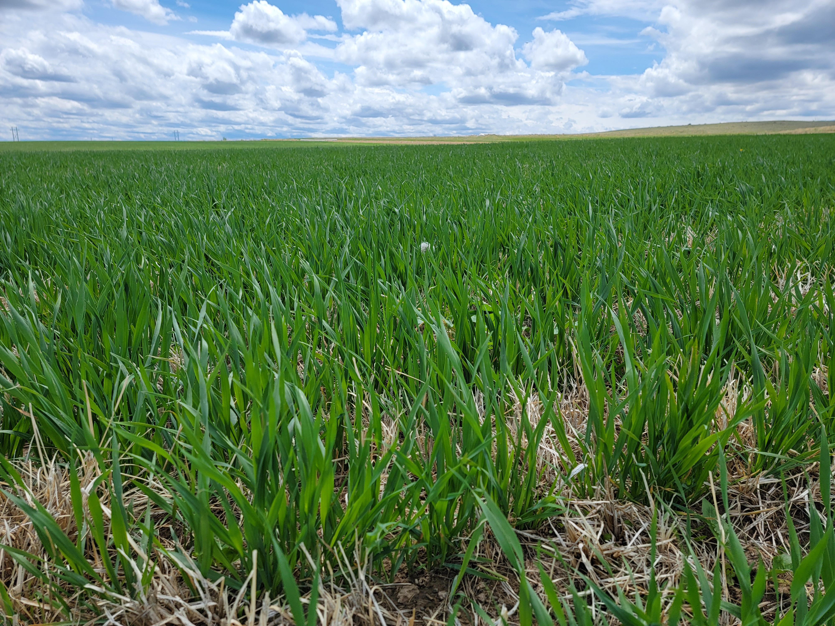
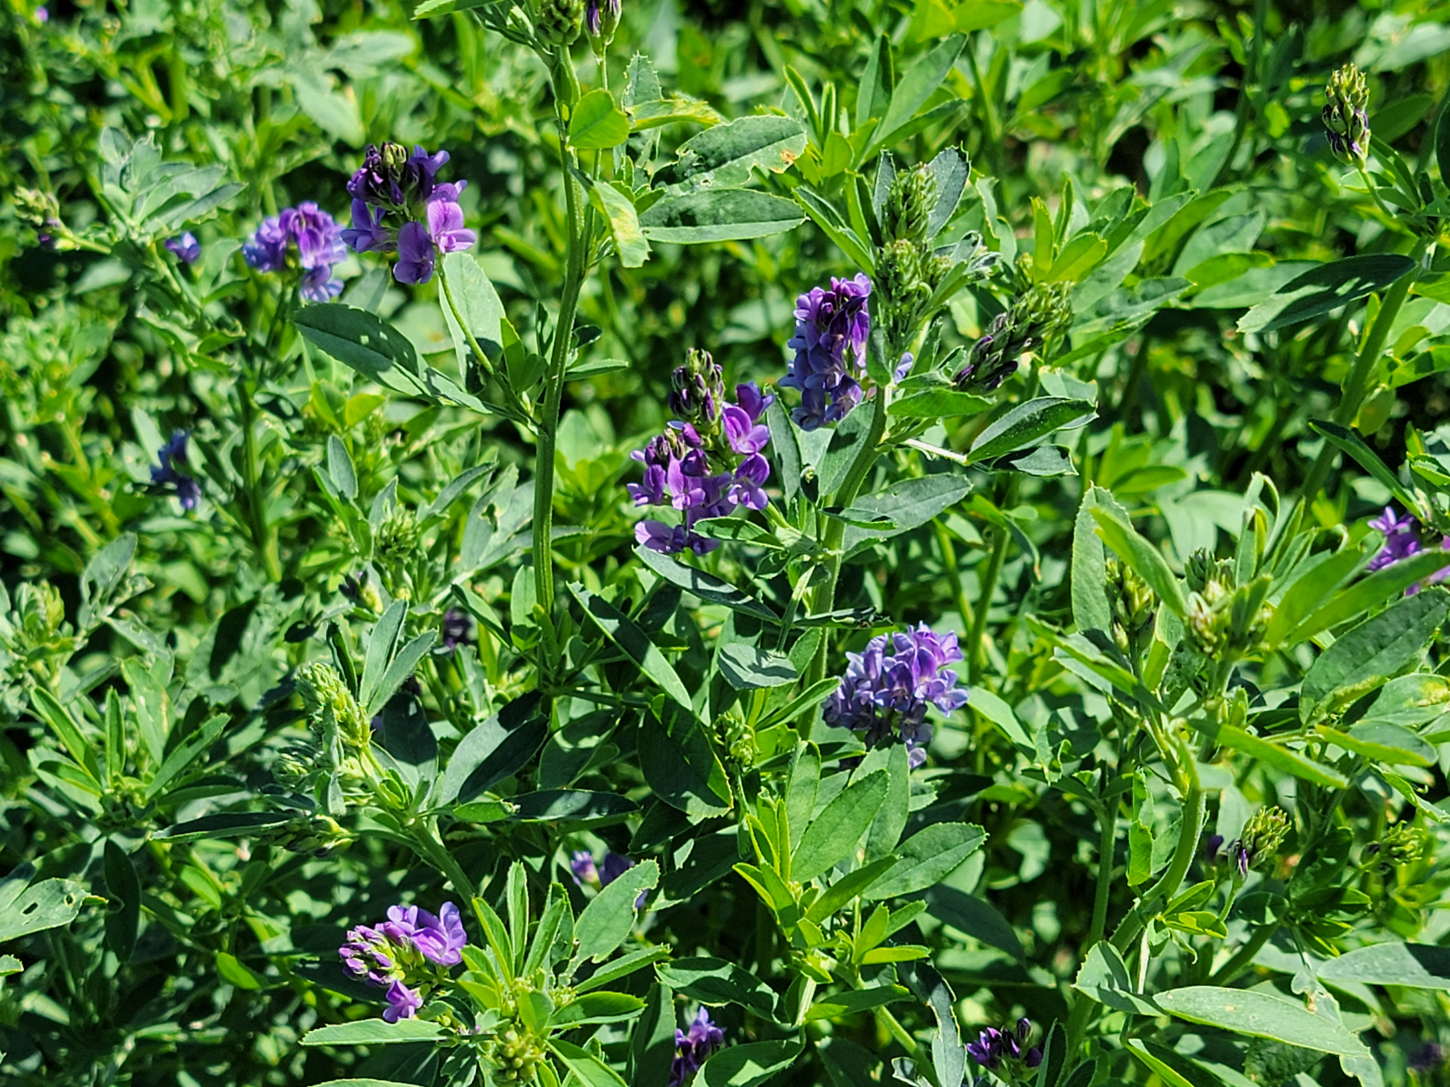
Notes:
Now that you have decided what you want to grow let's talk about how to make that happened. In the next few slides we will talk about field prep, fertilizing and seeding your fields.

Slide 8
Field Prep
(Step 1)
1. Start with a clean, level, smooth seed bed.
  You want no weeds, no clods or clumps of dirt, and not too soft or fluffy.
Notes:
Let's first get the field worked so you start with a nice clean, level, smooth seed bed.
You want no weeds, no clods or clumps of dirt, and not too soft or fluffy..

Slide 9
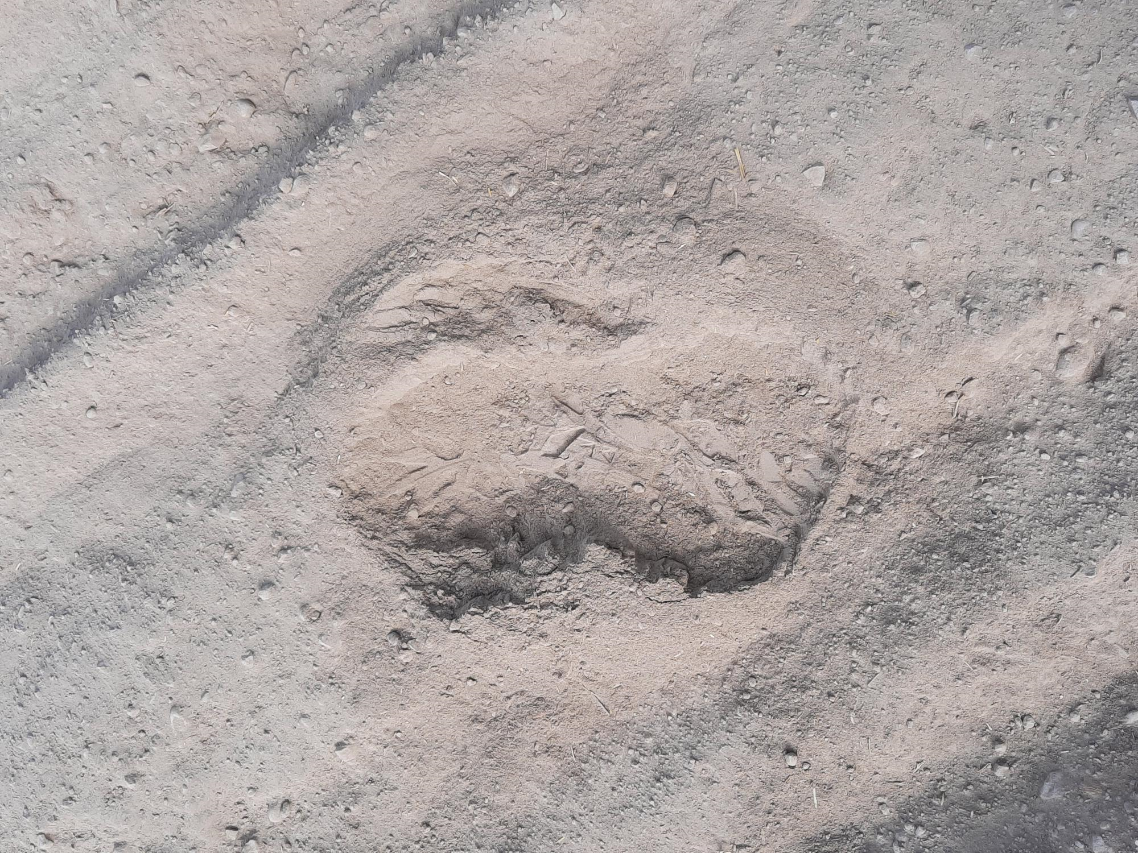
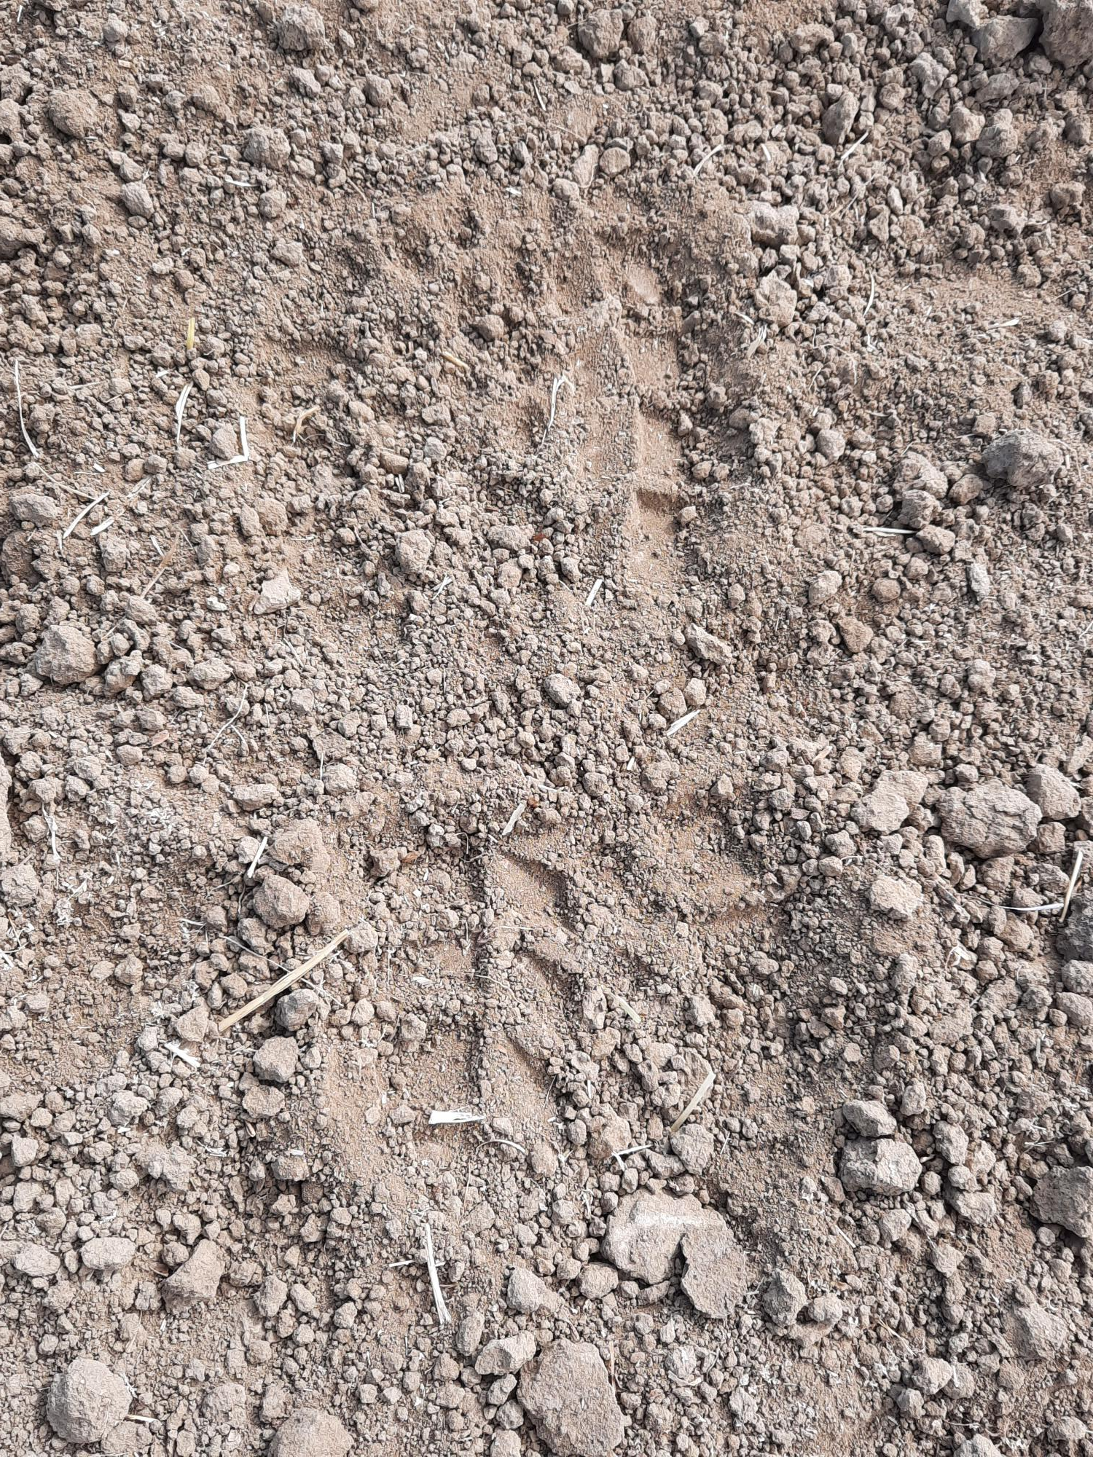
Too Soft
Just Right
Notes:
A good rule of thumb is that you want to be able to walk across the field and only see your heal and toe print in the dirt

Slide 10
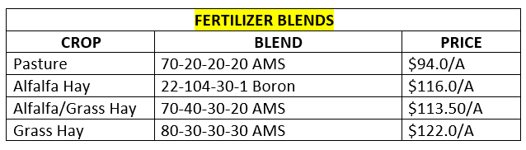
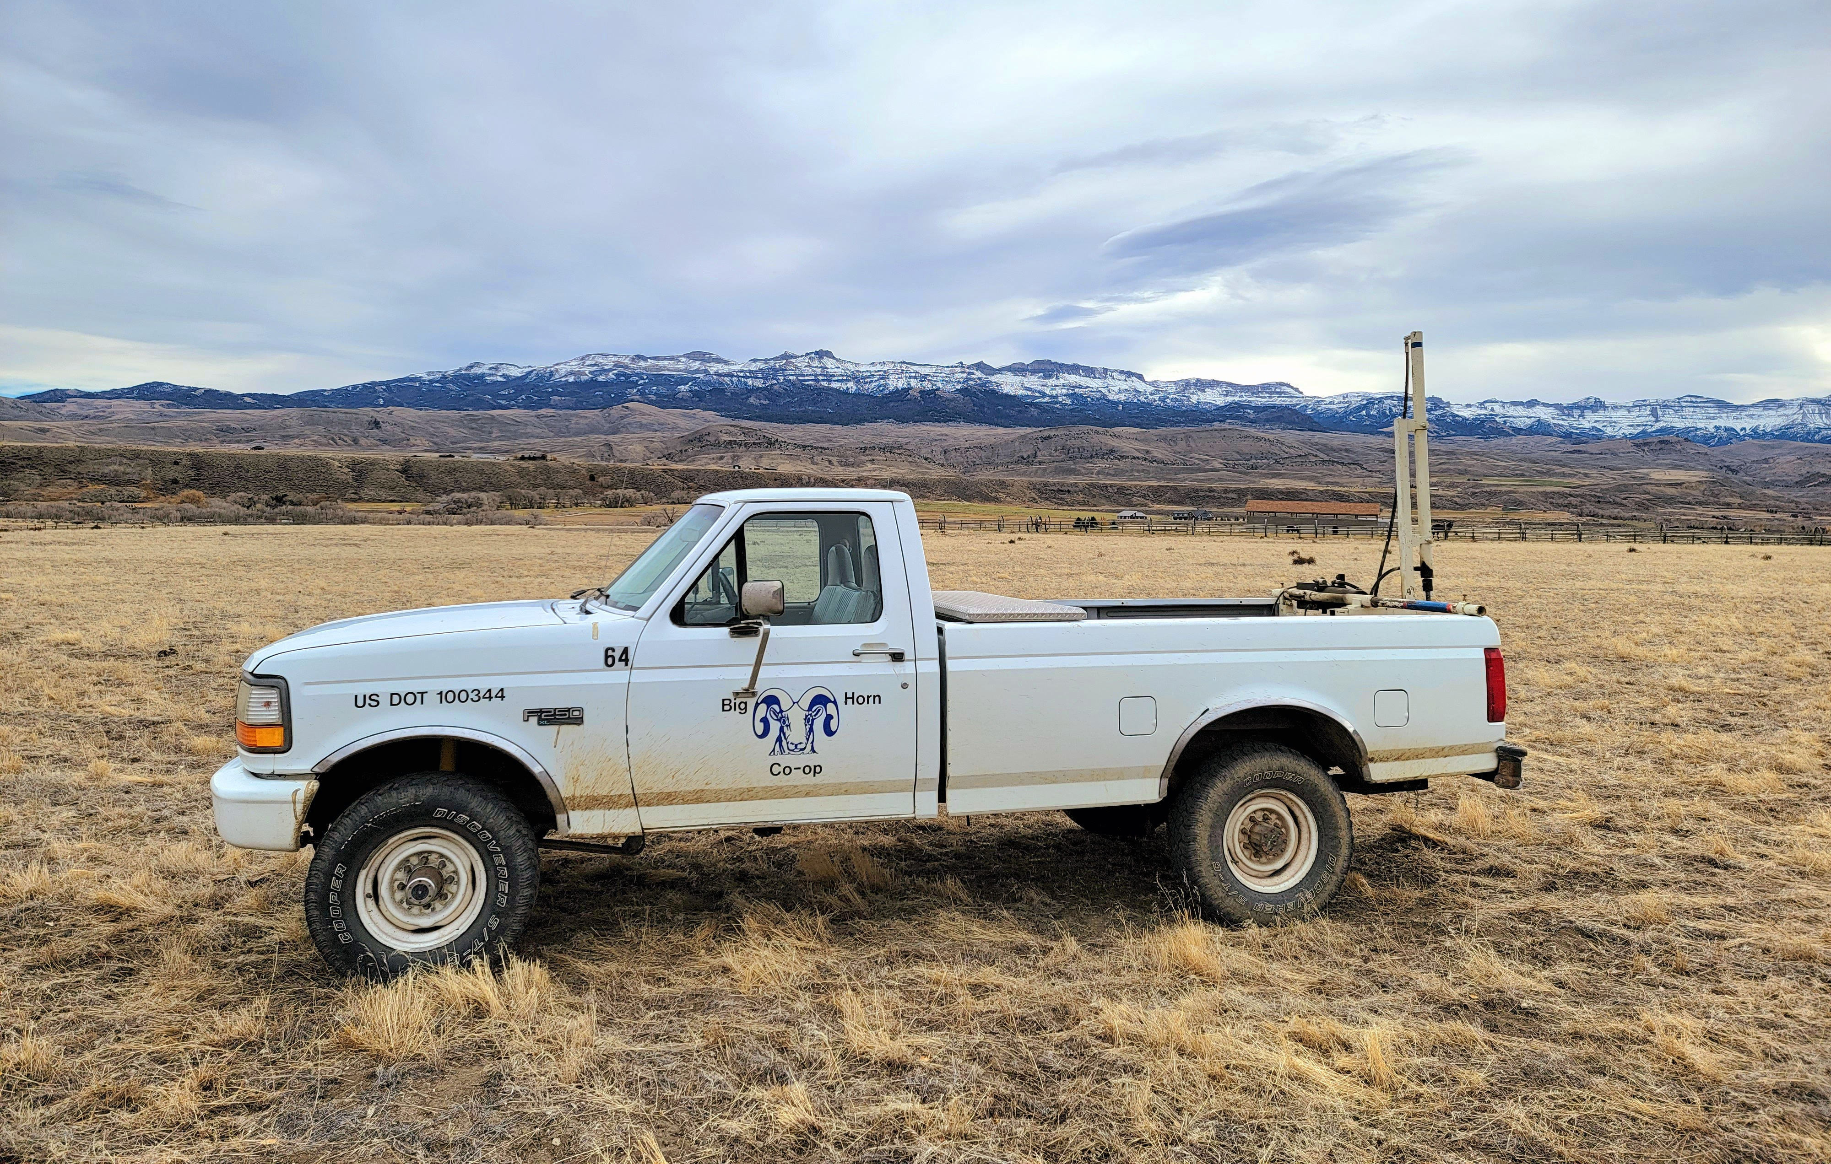
Fertilizer
(Step 2)
* Prices as of 3/25/2025. Prices are subject to change.
Soil Sampling is always recommended for best results. $55 per soil sample.
Notes:
Then we should fertilize the field. We always recommend taking a soil sample to get a good starting point to see where your field is really at and to get the best tailored fertilizer blend to maximize your production.
If you decide not to soil test, then these blends listed on the slide are our best recommended blend to put down on your field. Those are the current prices for those blends however those prices can change without warning. But for your budget this will give you an idea.
The co-op also has 40-pound bags of fertilizer available. It is an 18-18-18 blend and is $30 per bag. This is a good option for those with a larger lawn.

Slide 11
Fertilizer
Continued
* Prices as of 3/25/2025. Prices are subject to change.
Nitrogen - feeds the crop and promotes growth and tonnage by aiding in chlorophyll and enzyme processes and production.
Phosphorus - stimulates root, flower, and fruit development and overall crop maturity.
Potassium - is needed for overall plant health and good stock strength and to help the plant take up water.
Notes:
All our fertilizer blends offer the 3 main nutrients required for plant growth. That is nitrogen, phosphorus and potassium.
Nitrogen - feeds the crop and promotes growth and tonnage by aiding in chlorophyll and enzyme processes and production.
Phosphorus - stimulates root, flower, and fruit development and overall crop maturity.
Potassium - is needed for overall plant health and good stock strength and to help the plant take up water.
Most of our blends also include Sulfur and this is because sulfur helps to make the applied nutrients more available and easier to take up in our generally high pH soils.

Slide 12
Planting
(Step 3)
3. Seed your field.
  Sometimes Fertilizing and Seeding can be done in the same step with a spreader.
    Double Spread New Seeding.
    Roll or Scratch seed into the ground to achieve a good soil to seed contact.
  Drill your seed no deeper than a half inch deep.
    Drilling is the preferred method to planting seed.
Notes:
Sometimes Fertilizing and Seeding can be done in the same step. Something to note is that new seeding fertilizer is often different than the fertilizer you would use on an established field.
Drilling your seed in the ground at a depth no deeper than ½ and inch is the preferred method to seed a field and typically results in better stand establishment.
However, you can Double Spread New Seeding and make sure to roll or Scratch seed into the ground to achieve a good soil to seed contact.
Whether you use a spreader or drill make sure there is no excess foliage or dead plant material covering the ground that will hinder the soil to seed contact
You want to plant about 15 to 20 pounds per acre of Grass Seed and/or Pasture mixes and 20 to 25 pounds to the acre of alfalfa seed for new seedings. If inter seeding grasses into an established field, we want to plant about 10 to 12 pounds to the acre.

Slide 13
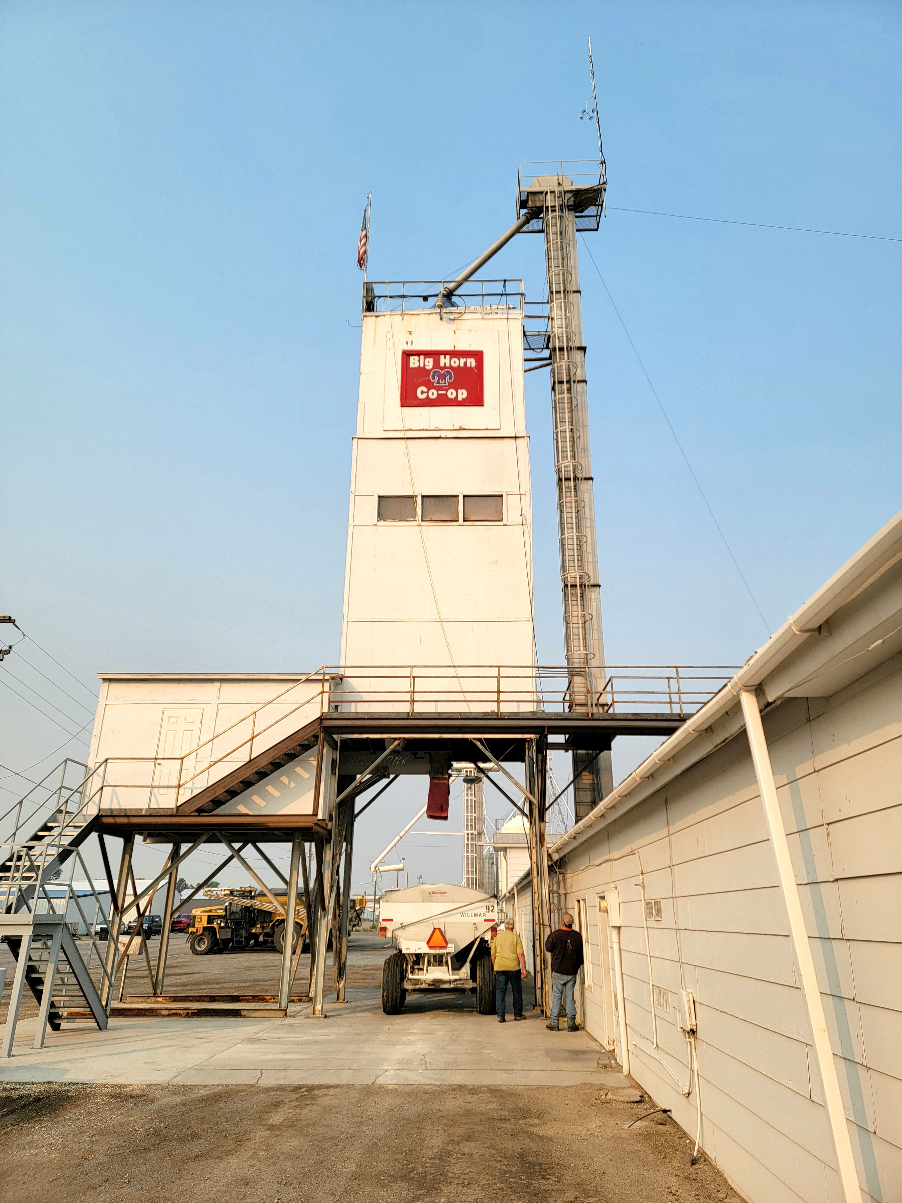
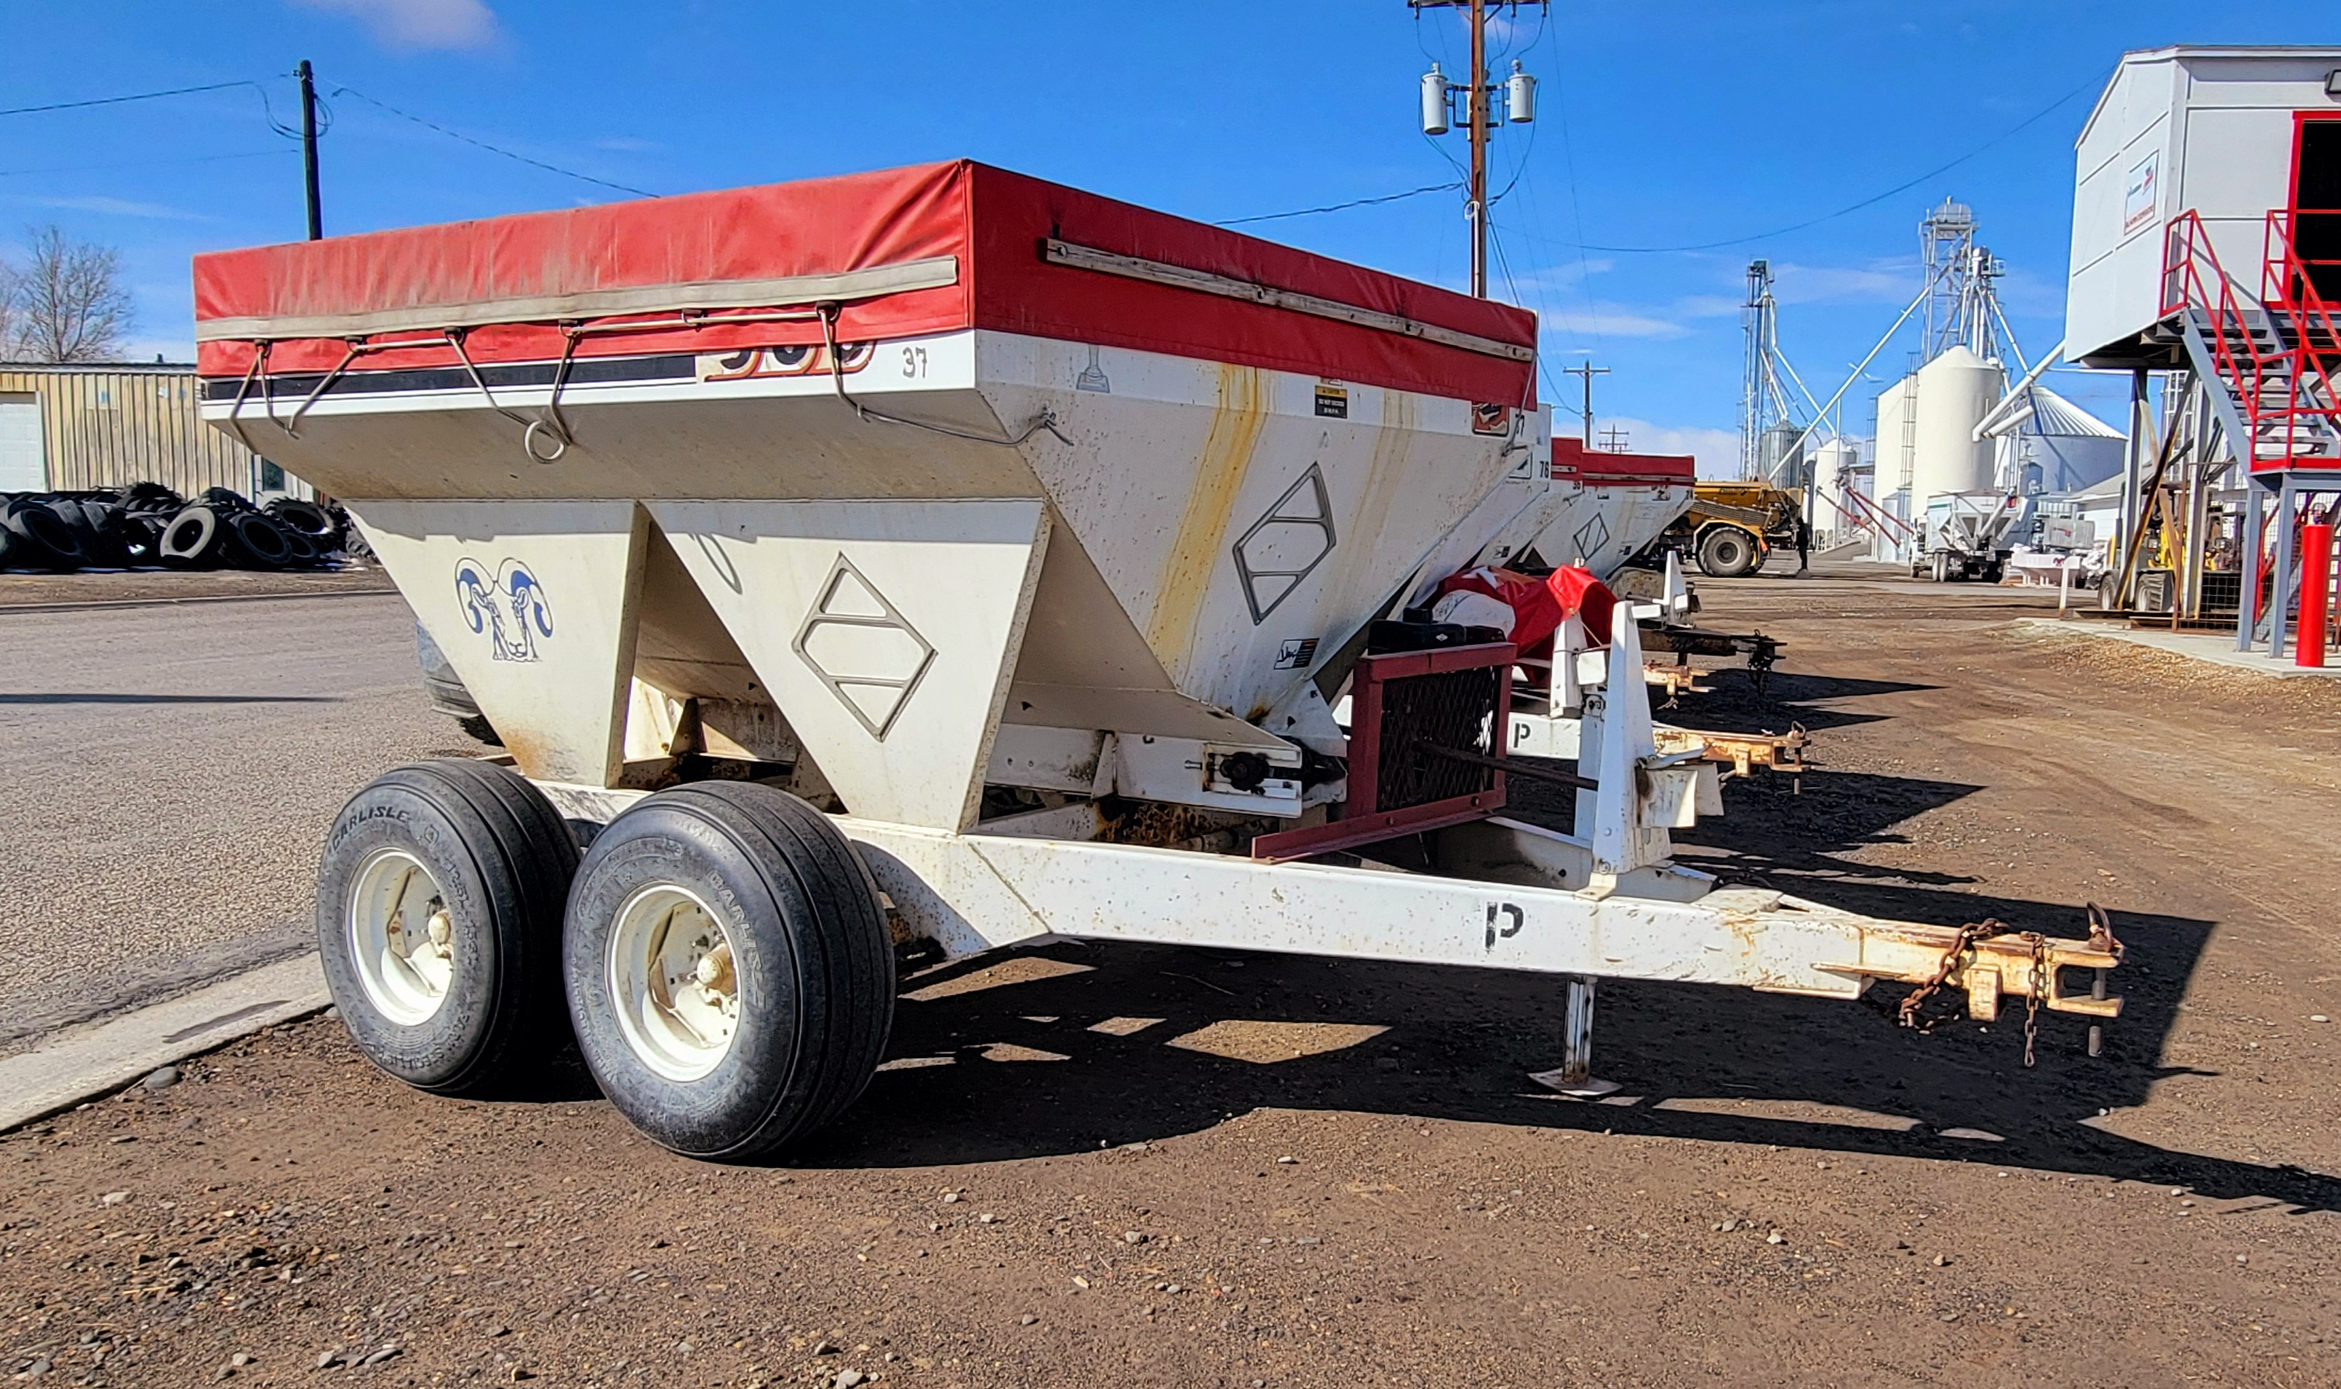
We have motorized gas carts and PTO carts available.
We can blend fertilizer and seed together to put into a cart.
Notes:
This is how it looks if you come to us to pick up your fertilizer and or seed.
These carts are what we recommend using to spread the product out on your field.
We have carts available that can be pulled behind a tractor or ones that can be pulled by a truck.

Slide 14
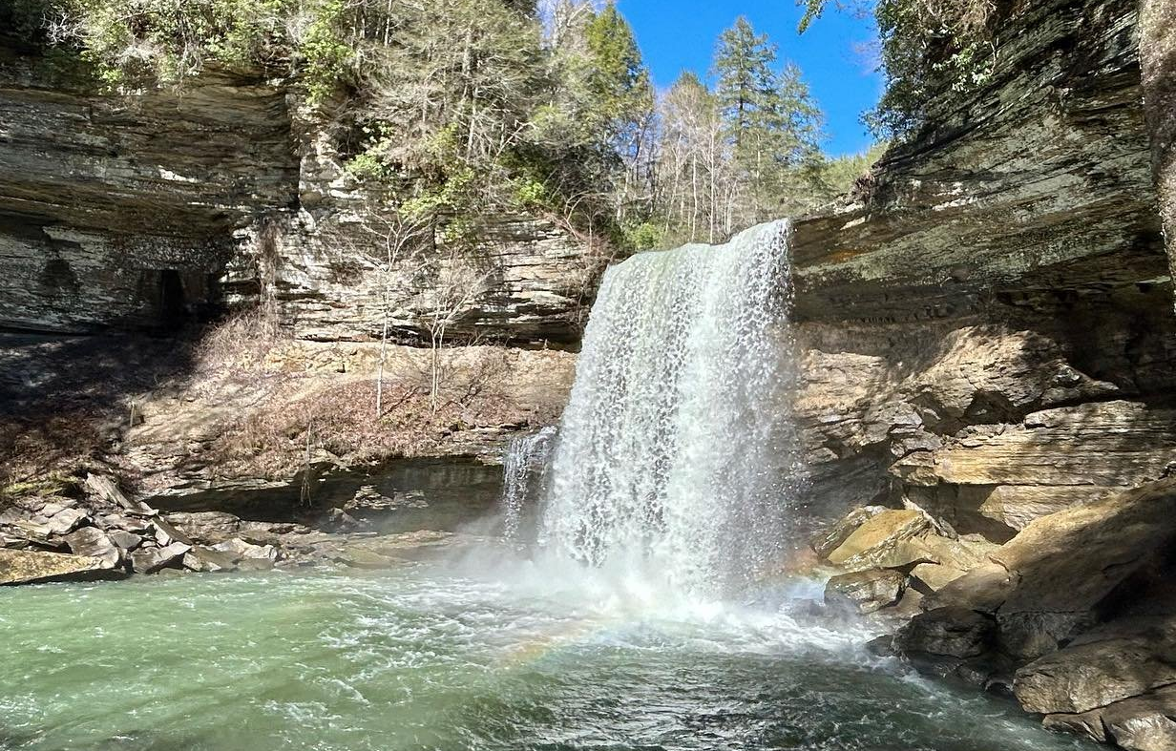
Water
(Step 4)
4. Water your field.
  Water is the most limiting factor following air and sunshine.
Notes:
Now that you have seeded and fertilized your field you need to complete the process by watering it.
Water is the most limiting factor following air and sunshine and is often hard to control and or figure out regarding application timing and method.

Slide 15

Professional Recommendation
Coming from experience…..
  Planting an annual crop is a cheap way to determine how to best manage your field.
    Use the first year to work out the kinks and practice planting, irrigating and harvesting.
  Some of the annual crop options we have are:
    Hay Barley, Oats, Wheat, Sorghum-Sudan, Triticale, Annual Ryegrass, Teff Grass
Notes:
As a side note and based on my professional experience;
If this is the first time you are attempting to work and water your field, I would recommend planting and fertilizing an Annual Crop.
That way you can experiment and practice with a cheaper option than possibly having a wreck will trying to establish a more permanent and expensive hay or pasture field.
The different Annual Crop options that work well in our area are:
Hay Barley, Oats, Wheat, Sorghum-Sudan, Triticale, Annual Ryegrass, Teff Grass
Prices for these are generally less than a dollar per pound and is typically significantly cheaper than more permanent options like alfalfa and grass hay blends.

Slide 16
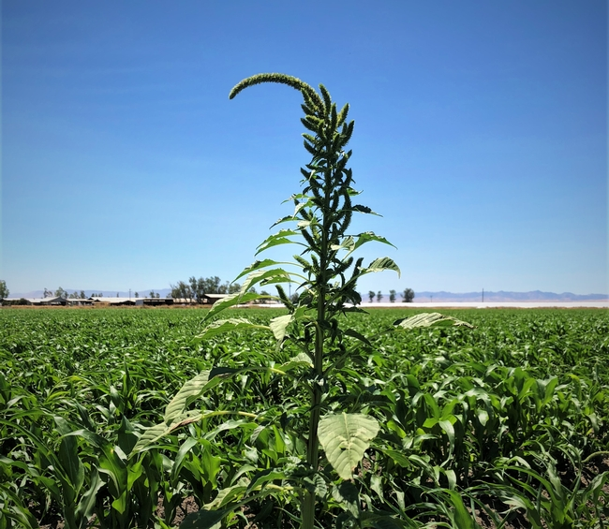
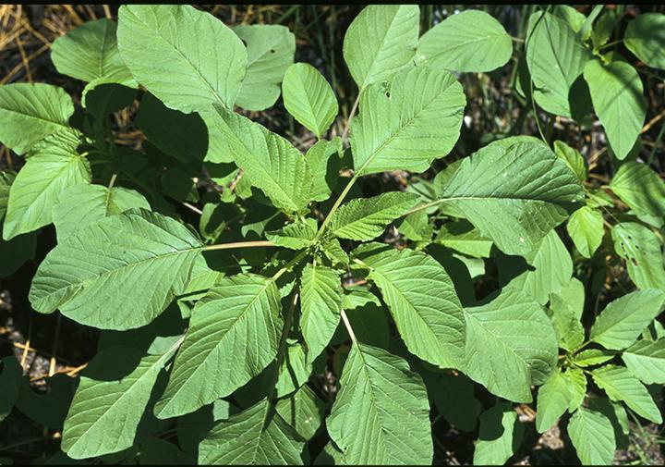
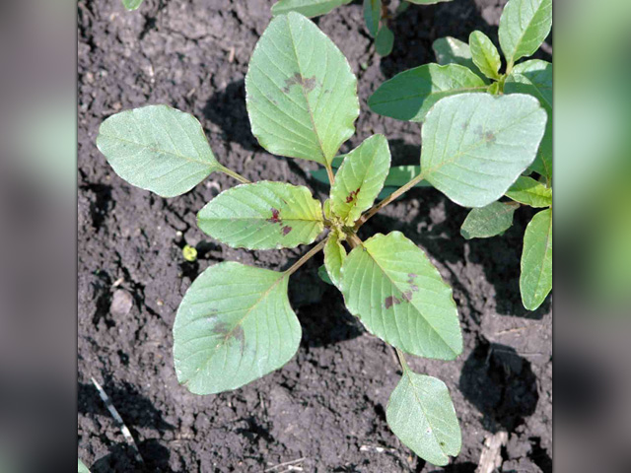
Palmer Amaranth “The Super Weed”
Easy to see when they are full grown but at that point it is too late.
Best to catch them when they are small, looks very similar to redroot pigweed which is common in many of our irrigated fields.
Notes:
I was not going to spend to much time on weed management, but I would like to note that some weeds are worse than others and this weed is a very bad weed.
If you see this weed, please let some one know. You can tell me, talk to the Weed and Pest, or contact the University of Wyoming Extension Agent.
This weed is very noxious and very hard to kill and control. You want to catch them when they are small, if they are full grown and putting on seed then it is probably too late.
At the smaller stages this weed looks very similar to its relative Redroot Pigweed, which is mostly harmless, but the one key difference is that it is smooth and hairless where Redroot Pigweed is covered in tons of tiny little pubescent hairs.
However, if you are unsure of what you are looking at feel free to check with a professional.

Slide 17
Weed Management
(Step 5)
5. Weed Management
  A clean seed bed and good stand establishment will help control weeds.
  We can kill weedy grasses in a stand of alfalfa.
  We can kill broadleaf weeds in a grass pasture or hay field.
  Glyphosate or Roundup Ready will kill everything other than those crops with the RR Gene.
Notes:
My recommendation to help manage a weedy field is to start with a clean and well-prepared seed bed and plant a solid rate of 20 to 25 pounds of straight RR alfalfa. Use the power of chemical applications to clean up any weeds you may have and fertilize and water your field efficiently to maintain crop health and development.
If you are just interested in managing a nice grassy pasture for your animals and you have no weedy grasses such as cheat grass or foxtail then planting a pasture mix is in a well-prepared field with good water management is very doable.
The key take away here for managing your weeds is that we can kill weedy grasses in a stand of alfalfa, and we can kill broadleaf weeds in a grass pasture or hay field.
If there is a lot of weedy grasses and broadleaves that need to be controlled, then RR alfalfa is the best way to go.
This is because RR alfalfa has the genetically modified gene that makes it resistant to the glyphosate or RR chemical, glyphosate is classified as a non-selective chemical meaning it will kill or damage all plants it comes in contact with other than those that are genetically resistant or tolerant. Although RR Alfalfa is considered a genetically modified organism, the tolerance to glyphosate occurs naturally in many plants especially in some common weeds such as kochia and in palmer amaranth, the weed you viewed on the previous page.

Slide 18
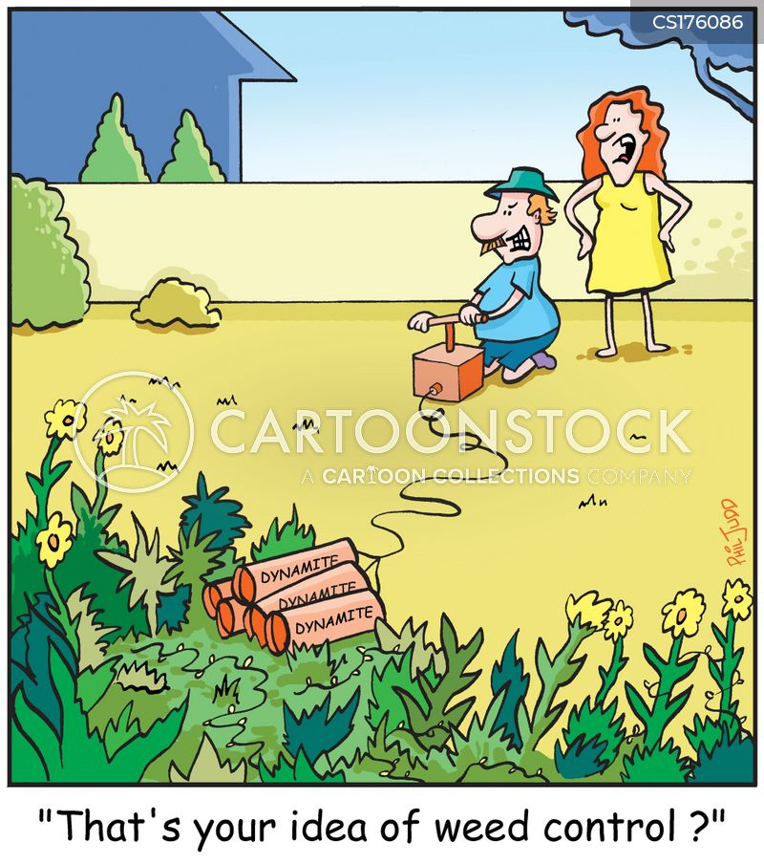
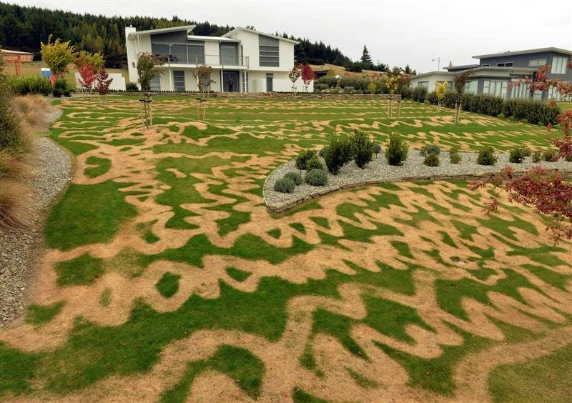
The moment you realized you grabbed the wrong chemical spray...
Notes:
This is why it is important to consult with an agronomist or with those down at the Weed and Pest if you are unsure of the weeds you are dealing with and to insure you are properly applying the right chemicals at the right time to kill what needs to be killed and not damage the desirable plants.

Slide 19
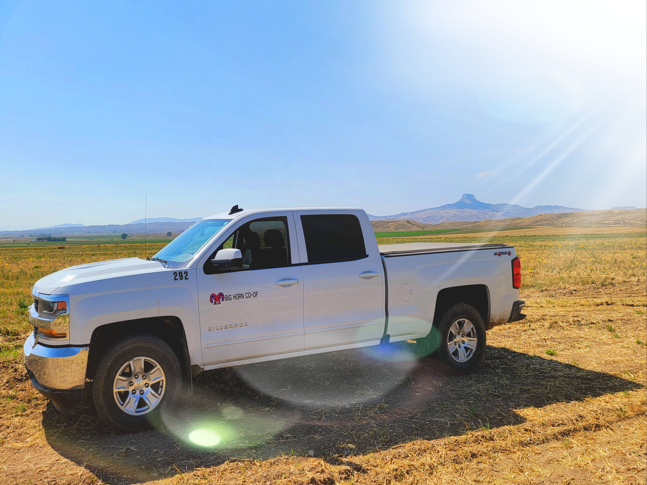
Austen Samet-Brown
Email: powell.cropadvisor@bighorncoop.com
Cell: 307-272-1738
Office: 307-754-5962
661 East North St., Powell WY
Questions?
Notes:
That is all I have for you today. If you have any questions, I would be happy to try and answer them now. Or come find me after this and I can give you my card incase something comes up latter down the road that you may need help with.

