Slide 1
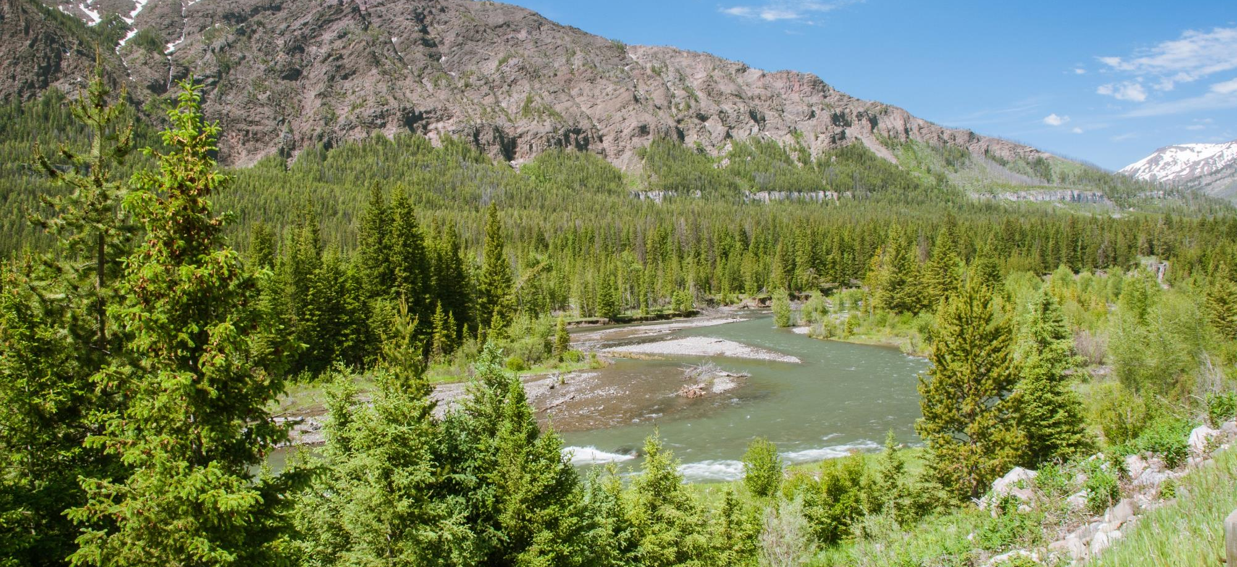

Wyoming Water Development Commission
Project Scoping Meetings Cody June 1, 2022
Powell June 2, 2022

Slide 2

Clarks Fork/Upper Shoshone Watershed Study, Level I
The Project is....
A collection of available information
A comprehensive inventory of the study area
Identification of water resources related local issues
Notes:
Jay slide:
Thanks for the opportunity
We have a lot to cover
These are the things we want to hit upon

Slide 3
Clarks Fork/Upper Shoshone Watershed Study, Level I
Why are we here?
Wyoming Water Development Commission Study
  WWDC has fully funded the project
  Participation is encouraged and strictly voluntary
25 Watershed Studies have been completed to date.
Cody and Powell / Clarks Fork Conservation Districts requested the study.
Trihydro Corporation was selected to complete it.
Notes:
Jay slide:
Thanks for the opportunity
We have a lot to cover
These are the things we want to hit upon

Slide 4
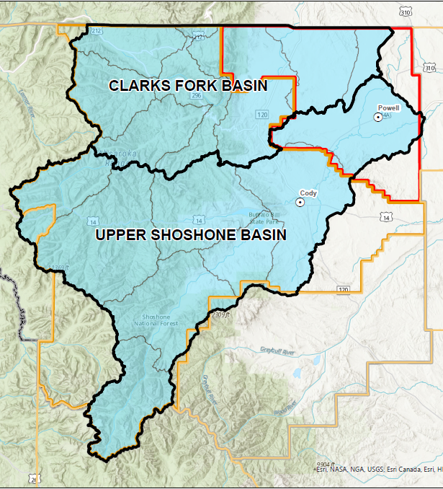
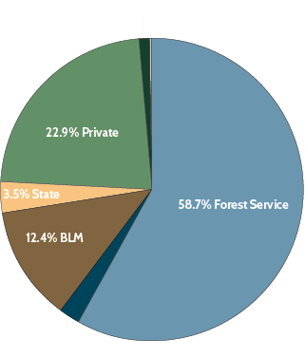

Project Study Area
Study Area Characteristics
2.3 million acres (3,500 sq. mi.)
Clarks Fork watershed 37.3%
Upper Shoshone River watershed 62.7%
The Study area includes:
  Cody and Powell and smaller towns along the mainstem of the Shoshone River.
  Relatively undeveloped:
    -National Forest
    -Rangeland
    -Irrigated Lands
Notes:
Jay Slide:
Study area is huge: two separate watersheds, over 2.3 million acres.
Probably the largest study area yet.
Roughly 2/3 shosone, 1/3 clarks fork
Mostly undeveloped but cody and powell experiencing growing pains
Increased demands on resources:
Groundwater quantity

Slide 5
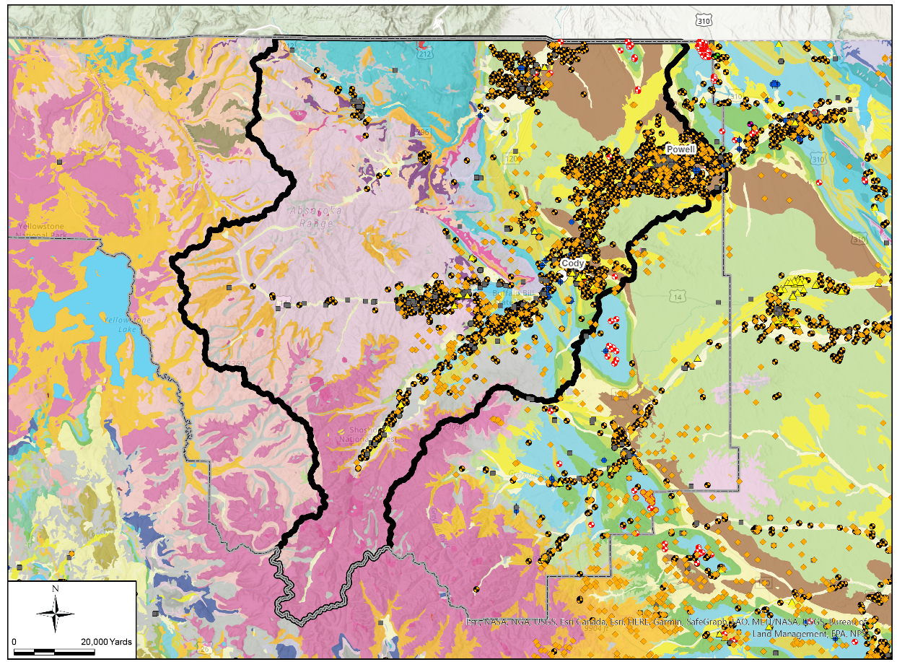

Project Study Area
Study Area Issues
Significant Growth
Subdivision of Lands
Agricultural Water Use
Water Quality Impacts
Sediment Delivery
Groundwater Demands
Septic Systems
Willwood Dam
Notes:
Jay slide:
Some of the issues facing the watersheds include:…..
Read the list....
This figure displays the abundance of wells in the study area: over ______

Slide 6
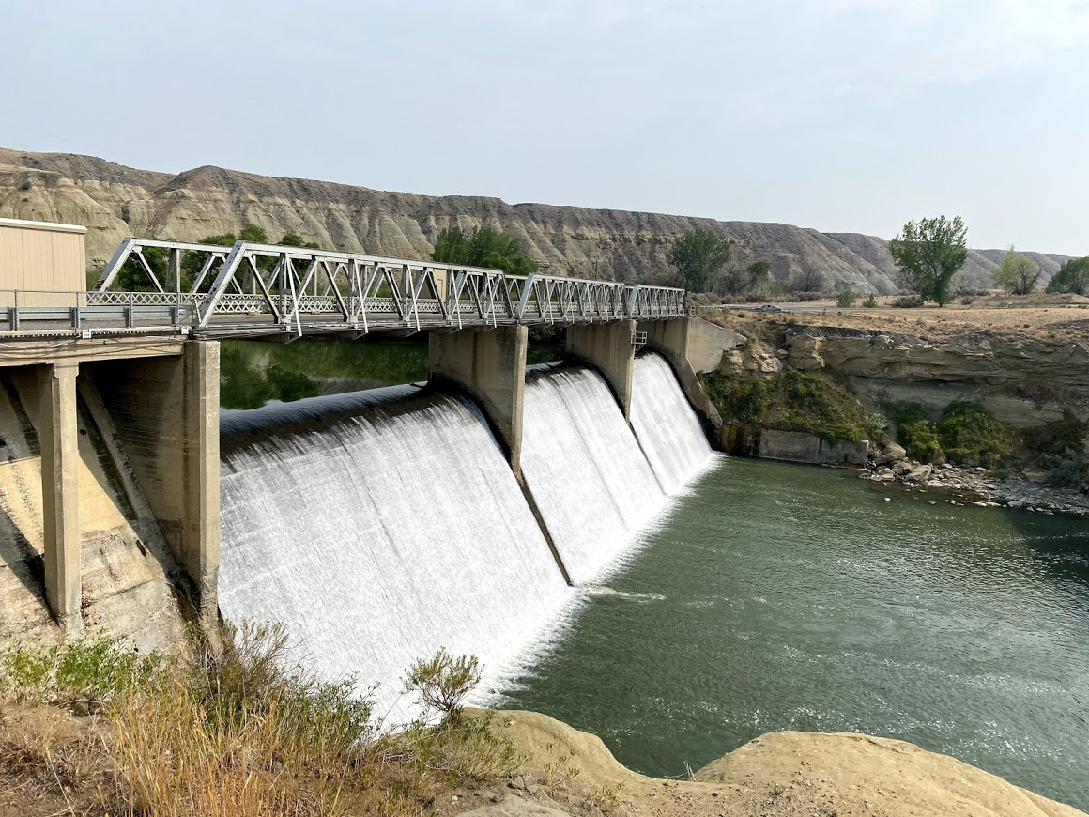
Project Study Area
Willwood Dam
Willwood Dam Operations
Sediment Delivery
Sediment Source Identification
WDEQ Working Groups (3)
Established Inertia
Notes:
Jay slide:
WIllwood Dam a driving force for the study
A lot of work already completed; we're not going to REDO this
We're going to incorporate it.
Special emphasis on the recommendations and BMPs from each group.
Incorporate these into our plan, find locations for specific implementation

Slide 7
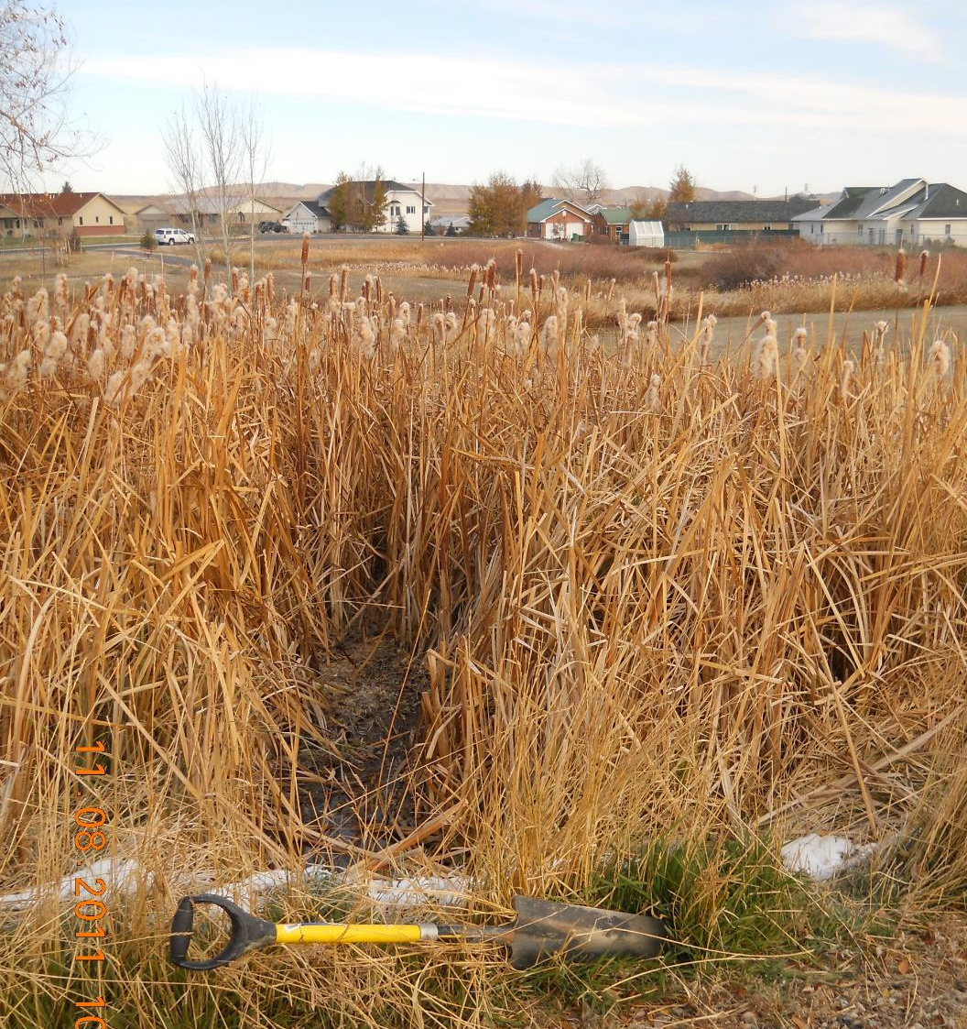
Our Approach
Task 1: Scoping and Project Meetings
Task 2: Review of Background Information
Task 3: Watershed Inventory & Description
Task 4: Streamflow Hydrology
Task 5: Management & Rehabilitation Plan
Task 6: Cost Estimates
Task 7: Economic Analysis
Task 8: Permits
Task 9: Discretionary Task
Task 10: Draft Report
Task 11: Report Presentations
Task 12: Final Report & Deliverables
Notes:
Scott Slide:
These are our primary tasks, as specified in the RFP
A lot to cover so let's roll

Slide 8
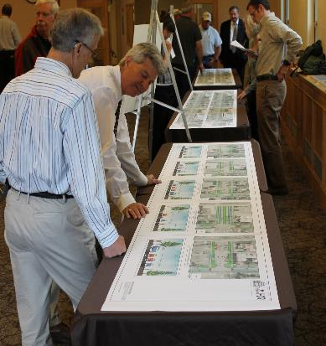
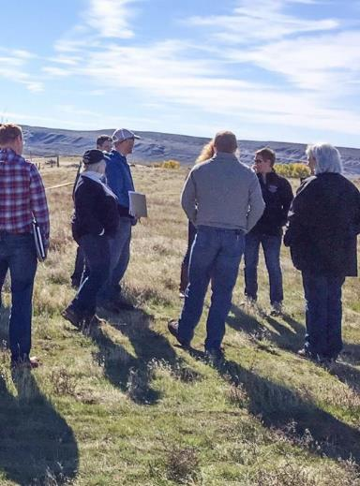
Task 1
Project Meetings & Public Participation
Public input is critical. Initiate with:
1. Scoping Meeting Proposed Agenda:
2. Project Workshops
3. Tailgate Talks
4. Webpage
5. Social media
Notes:
Scott slide
Project meetings = our chance to meet the locals and gain their trust
Encourage participation
People are busy, we schedule to avoid conflicts if we can (haying, calving, etc)
We NEED input: we're going to be here about a year and a half, you've been here generations
We NEED that expertise
Here's a list of some items we want to cover at our scoping meeting,
Includes discussion of a steering committee: previous studies yes and no.
Opportunity for engagement of CD board, local representative, irrigation district
Jay pop in: time to consider what's happening in Lander: Healthy Rivers Initiative.
Use this project as a spring board for the future; AFTER we've gone

Slide 9




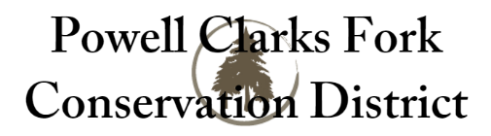



Task 2
Review Existing
Information
There is a LOT of information out there:
Contact all local, state, and federal agencies
Validate the current datasets and update digital library and geodatabase
Review mapped data with sponsors, landowners, and participants
Notes:
Scott slide:
A LOT of information to pull together
Our team is experts at data mining.
Written information AND digital data and spatial data
Examples: Wind/Bighorn Basin Plan Report AND Groundwater study, Willwood Working Group memoranda, Lower Shoshone Watershed Study and so on.

Slide 10
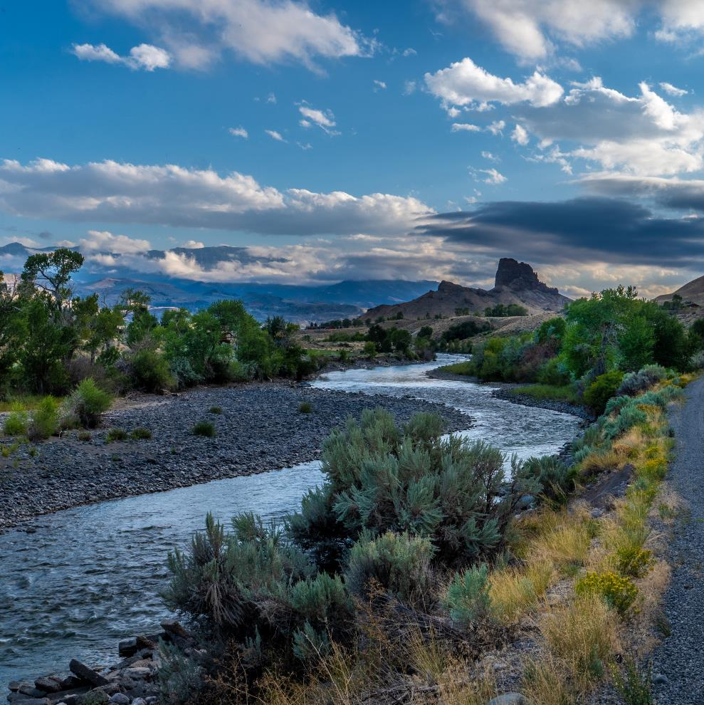
Task 3
Watershed Inventory
Task 3A: Physical Systems
Task 3A-I: Surface Water
Task 3A-II: Geomorphology
Task 3A-III: Groundwater
Task 3A-IV: Geology
Task 3A-V: Climate
Task 3B: Biological Systems
Task 3B-I: Fish and Wildlife
Task 3B-II: Land Cover
Task 3C Anthropogenic Systems
Task 3C-I: Agricultural Water Use
Task 3C-II: Domestic Water use
Task 3C-III: Water Storage
Task 3C-IV: Land
Technical Proposal Contains Detailed Descriptions of These Efforts
Notes:
Scott slide
This is the biggest task of the project
Could talk for hours about the entire scope; it's all in our proposal
Want to highlight a few important sub tasks

Slide 11
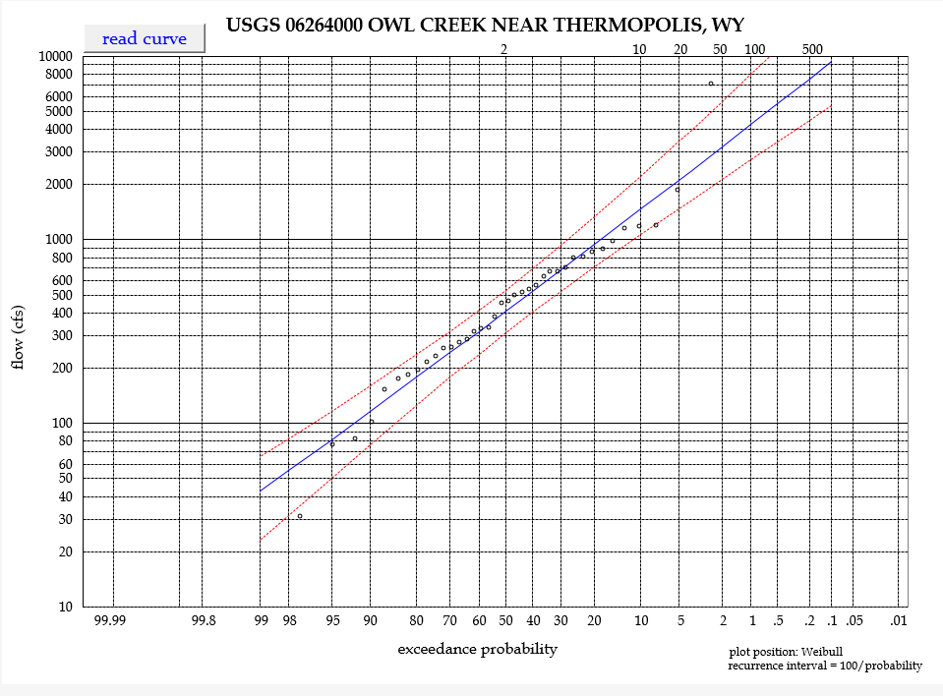
Streamflow Hydrology
Task 4
Task 4: Streamflow Hydrology
Update pertinent water budget estimates in the Wind/Bighorn Basin plan (2010)
Use same methods as in the Wind/Bighorn plan for consistency
Peak flow analysis
Notes:
Jay Slide:
Simple on the surface; complex when you're familiar with what's entailed
Consequently, one of the more costly tasks.
Update pertinent portions of the WInd/BIghorn Planning study water budget
Involves evaluation of hydrologic record, determination of wet/normal/dry years,
Updating diversion records (we'll coordinate with WSEO hydrographers)
I co-wrote the actual spreadsheet/ am familiar with how to use and build it.
Information valuable in assessing viability of potential projects
Additional hydrology tasks:
Peak flow analysis

Slide 12
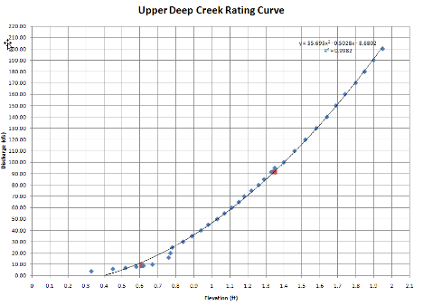
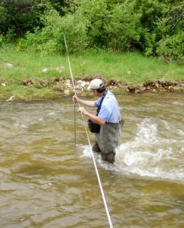
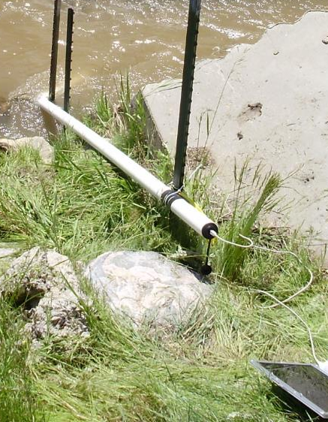
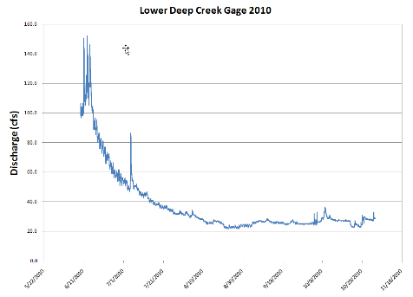

Streamflow Hydrology
Task 4
Subtask I: Temporary Stream Gages
Site Selection:
Coordinate with WWDO and CD's
Landowner consent
Access
Historic gage locations
Ability to develop rating curves
Consider data needs to support
Potential projects in the plan
Suitability of site to meet the
Objectives of the study
Notes:
Jay slide:
We'll meet with the CDs to determine if and where they would like temporary stream gages.
We've installed dozens in a wide variety of local conditions
Some suggestions might include locations where irrigation return flow data would be valuable
Or ungaged tributary flagged by the WIllwood groups as a potential sediment source

Slide 13
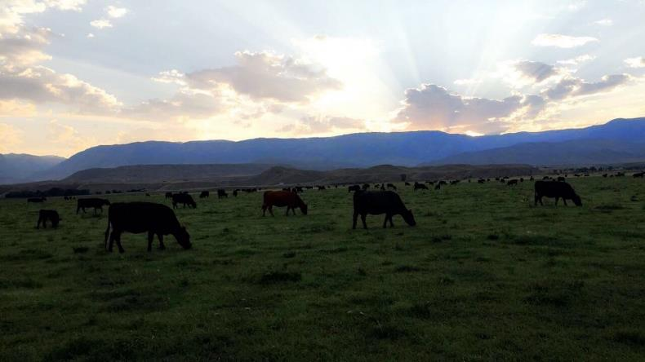
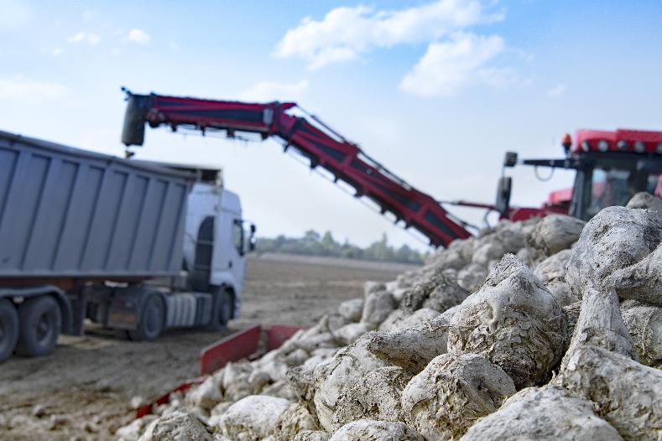
Task 5
Watershed Management & Rehabilitation Plan
GOAL: Develop and Evaluate Practical and Economical Alternatives
Components of the Plan:
  A. Water Storage and Conservation
  B. Upland Livestock/Wildlife Management
  C. Stream Channel Stability
  D. Irrigation Rehabilitation
  E. Water Quality Management
  F. Wetland Development & Enhancement
  G. Grazing Management Alternatives
  H. Groundwater Recharge
Evaluate, Describe and Prioritize
Project Plans, Maps, Designs, and Costs
Facilitate Preparation of SWPP applications
Notes:
"This is what it all comes down to, The Plan"
Incorporate all the project components identfied during the Inventory phase
8 categories; multiple individual potential projects within each.
For each project a written description, cost estimate, conceptual design.
Objective: "Application Ready documentation"
We'll show examples of a few component types

Slide 14
Small Water Development Program
To provide grant funding for Small Water Development Projects that improve watershed condition and function and provide benefits for…
Funding
50% grants up to $35,000 are available for eligible projects that provide adequate public benefit, improve watershed health, and meet the program definitions as outlined in the criteria.
Livestock
Wildlife
Irrigation
Environmental
Recreational
Livestock
Wildlife
Irrigation
Environmental
Recreational

Slide 15
Small Water Development Program
Eligible projects include
Small Reservoirs
Wells
Solar Platforms
Pipelines and Conveyance Facilities
Springs
Wetland Development
Environmental
Irrigation
Windmills
Rural Community Fire Suppression
Recreational
Livestock
Wildlife
Irrigation
Environmental
Recreational

Slide 16
Small Water Development Program
Criteria…
Small Water projects must adequately demonstrate a public benefit. Public Benefits may be demonstrated for projects included in WWDC Watershed Studies. Eligible projects may be located on Federal, State, public, or private land.
Livestock
Wildlife
Irrigation
Environmental
Recreational
* This is a Constitutional Requirement

Slide 17
Small Water Development Program
Sponsors are asked to…
Specifically address the resource benefits of their project
Explain how distribution of livestock will improve the health of the watershed.
Address how watershed health is improved and why public dollars are justified for every project in every application.
Not use the following “…improved economics for the county…” as a benefit. Water Development is not in the economic improvement business.
Examples
Wildlife Habitat Improvements
Sage Grouse
Improved Riparian Condition
Fish Passage
Water Quality Improvements
ETC…
This is not an exhaustive list.
Livestock
Wildlife
Irrigation
Environmental
Recreational

Slide 18
Task 6
Cost Estimates
“Application Ready” project descriptions and cost estimates
Notes:
Jay slide
Cost estimates for all Watershed Management Plan COmponents
Use current and local cost factors
NRCS databases for small projects

Slide 19
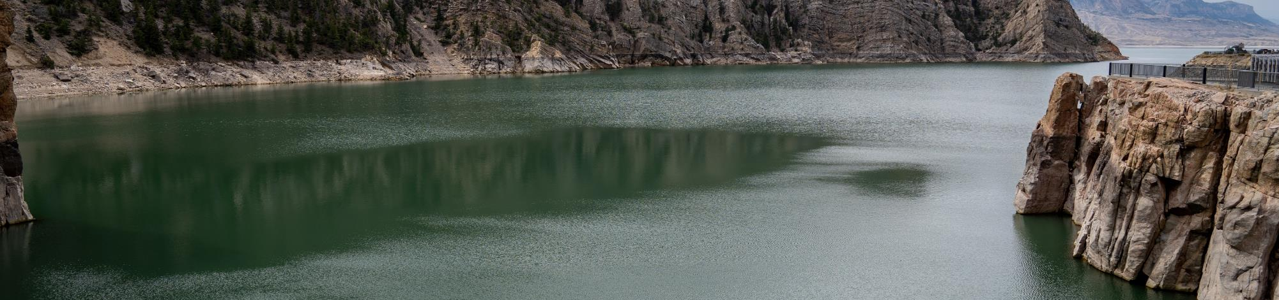
FUNDING ALTERNATIVES
Federal Sources
Task 7
Economic Analysis
Bureau of Land Management
  Riparian Habitat Management Program
  Cooperative Agreement for Range Improvements
Natural Resources Conservation Service (NRCS)
  Environmental Quality Incentives Program (EQIP)
  Watershed Protection and Flood Prevention Program (PL566)
  Wetlands Reserve Program
  Wildlife Habitat Improvement Program (WHIP)
  Emergency Watershed Protection
  Small Watershed Rehabilitation Program
  Grazing Lands Conservation Initiative Grants
United States Environmental Protection Agency
  Nonpoint Source Implementation Grants (319 Program)
  Watershed Assistance Grants
  Wildlife Habitat Incentives Program (WHIP)
US Army Corps of Engineers
  Flooding problems funding
Farm Service Agency (USDA)
  Conservation Reserve Program
  Continuous sign up High Priority Conservation
  Practices
US Department of Commerce National Oceanic and
Atmospheric Administration (NOAA)
  Community-Based Restoration Program (CRP)
State Sources
Office of State Lands and Investments
  Farm Irrigation Loans
  Small Water Development Project Loans
Wyoming Game and Fish Department
  Riparian Habitat Improvement Grant
  Water Development/Maintenance Habitat Grant
  Upland Development Grant
  Wyoming Sage Grouse Conservation Fund
Wyoming Water Development Commission
  Wyoming Water Development Program
  Small Water Project Program
Wyoming Wildlife and Natural Resources Trust
Find Partnering Opportunities
Offset Project Costs
Notes:
Scott slide
For each project, potential funding sources will be identified
Justin Krajewski will support here
We'll provide guidance on packaging projects and finding best potential source of funding, where and how to apply.
(In addition to SWPP)

Slide 20
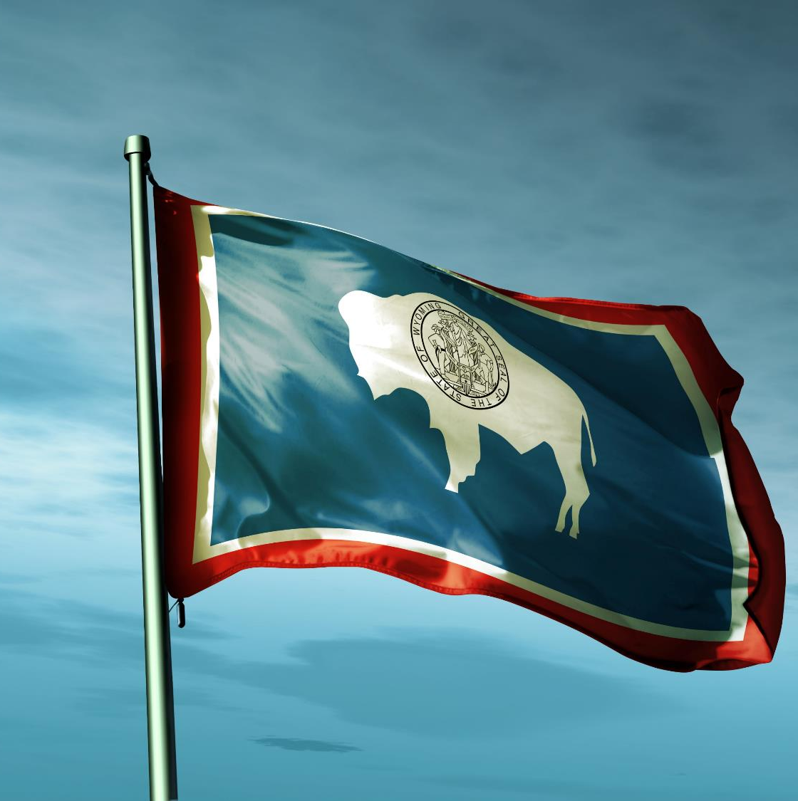
Task 8
Permitting
PERMIT REQUIREMENTS DETERMINED FOR ALL PLAN COMPONENTS, will include:
NEPA Compliance (EIS)
U.S. Army Corps of Engineers Section 404 permits
Wyoming Department of Environmental Quality/Water Quality Division NPDES Stormwater Discharge Permits for Construction Activities and Section 401 Certification
Endangered Species Act (Section 7 Consultation)
Fish and Wildlife Coordination Act
Wyoming Board of Land Commissioners
Wyoming State Historic Preservation Office archaeological clearances
Wyoming State Engineer’s Office Surface Water Storage Permit
Wyoming State Engineer’s Office Permit to Construct/Dam Safety Review
Notes:
Jay Slide
Permitting requirements will be identified for all plan project components.
Will provide guidance on requirements for each type of permit and whom to contact.

Slide 21
HOW CAN YOU PARTICIPATE?
Attend Project Meetings and Workshops
Provide Input
  Water Issues
  Stream Channel Conditions
  Irrigation Infrastructure
  Local Issues
On-Site Visits / Small Water Project Program
Notes:
Scott slide
For each project, potential funding sources will be identified
Justin Krajewski will support here
We'll provide guidance on packaging projects and finding best potential source of funding, where and how to apply.
(In addition to SWPP)

Slide 22
CONTACT US
Carmen McIntyre: pcfcd1@gmail.com
Brittany Swope: conservecody@gmail.com
Notes:
Scott slide
For each project, potential funding sources will be identified
Justin Krajewski will support here
We'll provide guidance on packaging projects and finding best potential source of funding, where and how to apply.
(In addition to SWPP)

