Slide 1
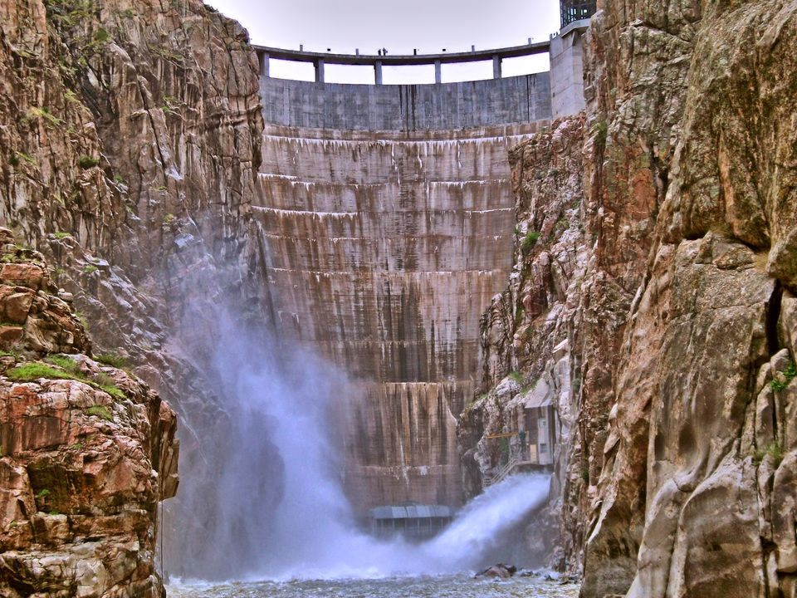
Rural Living Workshop
2025

Slide 2
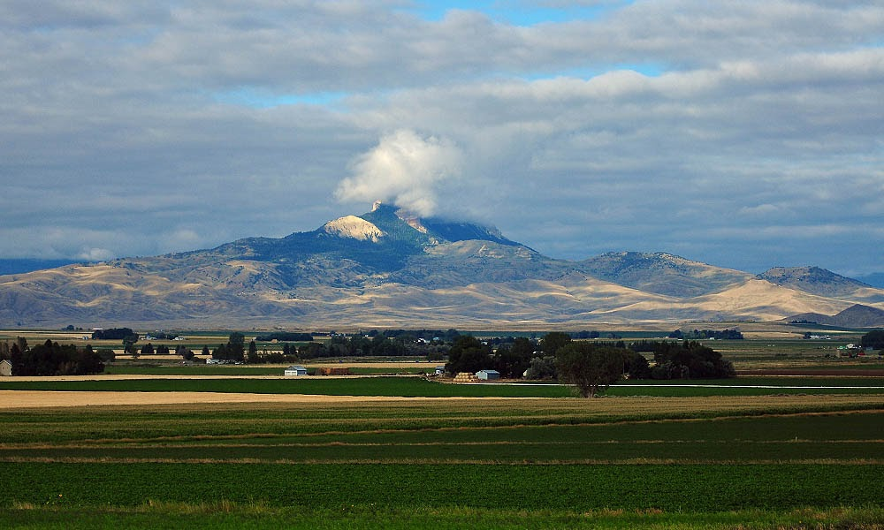
What is an Irrigation District? What do we do?

Slide 3
History and Purpose
The Shoshone Project is one of the earliest Irrigation projects that the Federal Government funded to open the west to new opportunities. Its main objectives was to bring water to arid desert lands and transform them into productive farmlands.
The project was designed as a single purpose project with Buffalo Bill Dam being a single purpose dam for storage for the project.
With out the Buffalo Bill reservoir the area would remain as a high plains desert
The Shoshone Project consists of four Districts; Shoshone, Heart Mountain, Willwood, and Deaver

Slide 4
What do we do and what are our responsibilities?
The responsibilities of the Irrigation Districts are to deliver water to the high point of each farm unit as designed by the Bureau of Reclamation.
They maintain the infrastructure of open canals and laterals as well pipelines that deliver water to the farm units. They also maintain many miles of open drains as well as underground drains to manage run off waters from the farm units
The Irrigation Districts have a ditch rider that is responsible for turning the water into these head gates on the farm units. Most of the Irrigation districts have a requirement of 24 to 48 hours of notice for on and off cards. This is so we can make adjustments to the system if we need to increase flows for demand purposes.
Once the water has been turned in at the headgate it is then the responsibility of the water user/Landowner to take care of the water and make sure it maintains its proper channels.

Slide 5

District Easements and Right-of-ways
The Irrigation Districts in the Shoshone Projects have Right-of-Ways and easements along district laterals and canals.
This is so we can continue to maintain the infrastructures, that we can continue delivering constant water to our users.
According to the 1890 Canal act and its amendment (44 Stat.668) on May 28, 1926, a right-of-way of 100 ft on each side of the canals and laterals. This is a Federal Right-of-Way on all United States Bureau of Reclamation Projects.
The district trys to work with landowners if possible but there are times in which we need the full easement to maintain facilities for cleaning or upgrading the system into pipelines.
Trees, fences and buildings will need to maintain the right-of-ways if all possible, that way there are no obstruction for maintenance and repairs.

Slide 6
Irrigation Practices and Methods

Slide 7
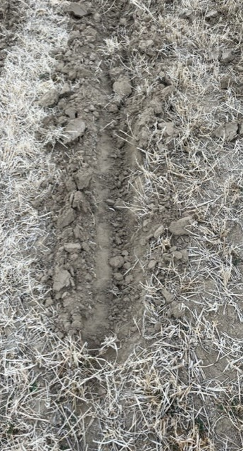
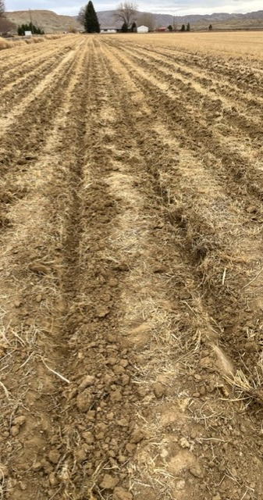
Corrugations in Flood irrigation
This allows for a good clear path for the water to travel to the end of the field. This also allows for even water distribution across the field. It is very important to have good corrugations in your fields and pastures to ensure efficient irrigation practices
It is also important to maintain a good waste ditch for the runoff to be captured so it has a good clear path to leave the field

Slide 8
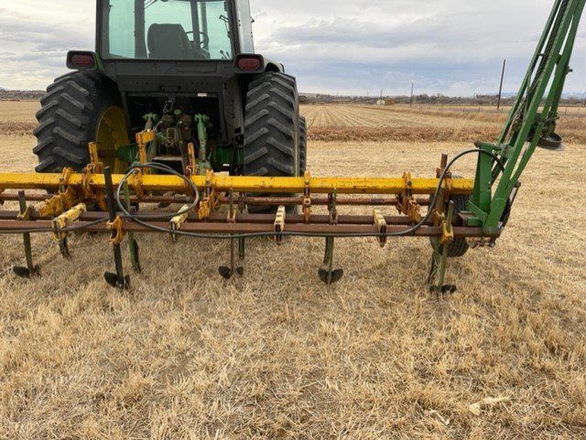
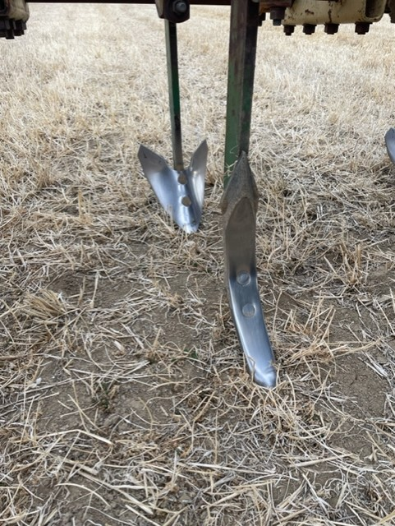
What is a Corrigator?

Slide 9
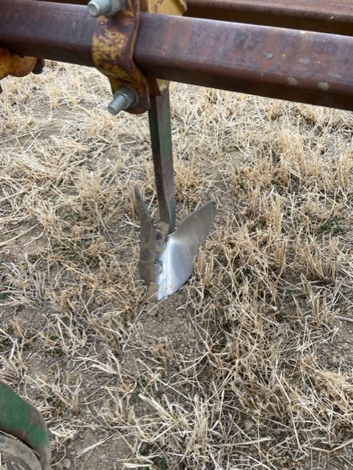
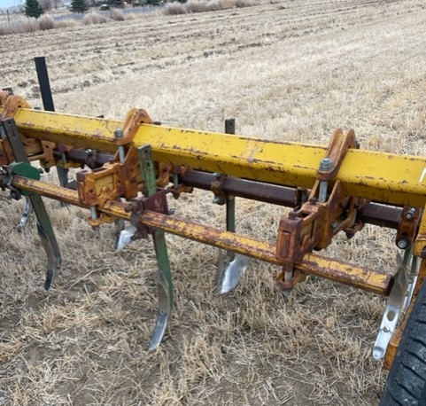
A corrugator is used to make the small ditches in the field so that the water has a channel to follow.
There are a couple places that have them and a small tractor to rent out or you can build one if you have a small tractor

Slide 10
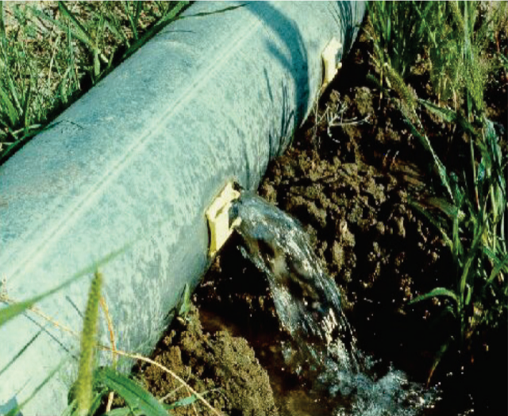
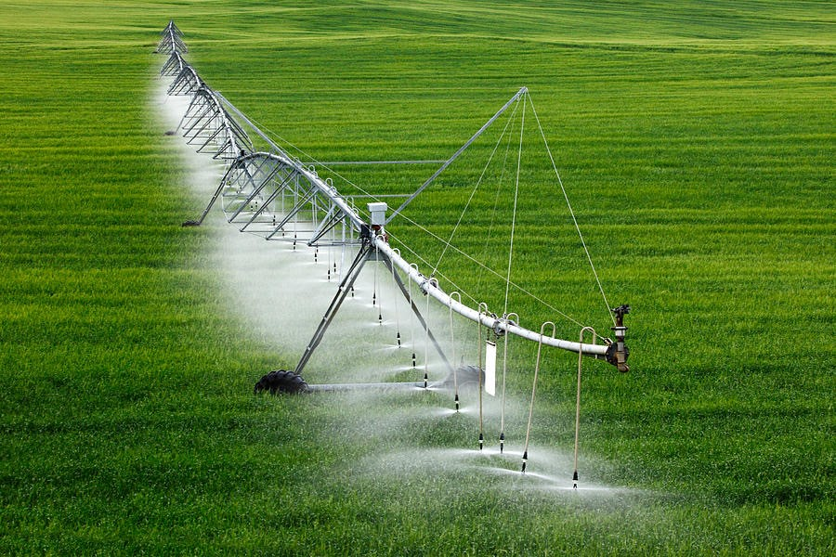
Other types of irrigation
Gated Pipe is used as a method in flood irrigation as well as Siphon tubes
Pivot or sprinkler irrigation is also another form of irrigation that is very efficient and has no return water to manage

Slide 11
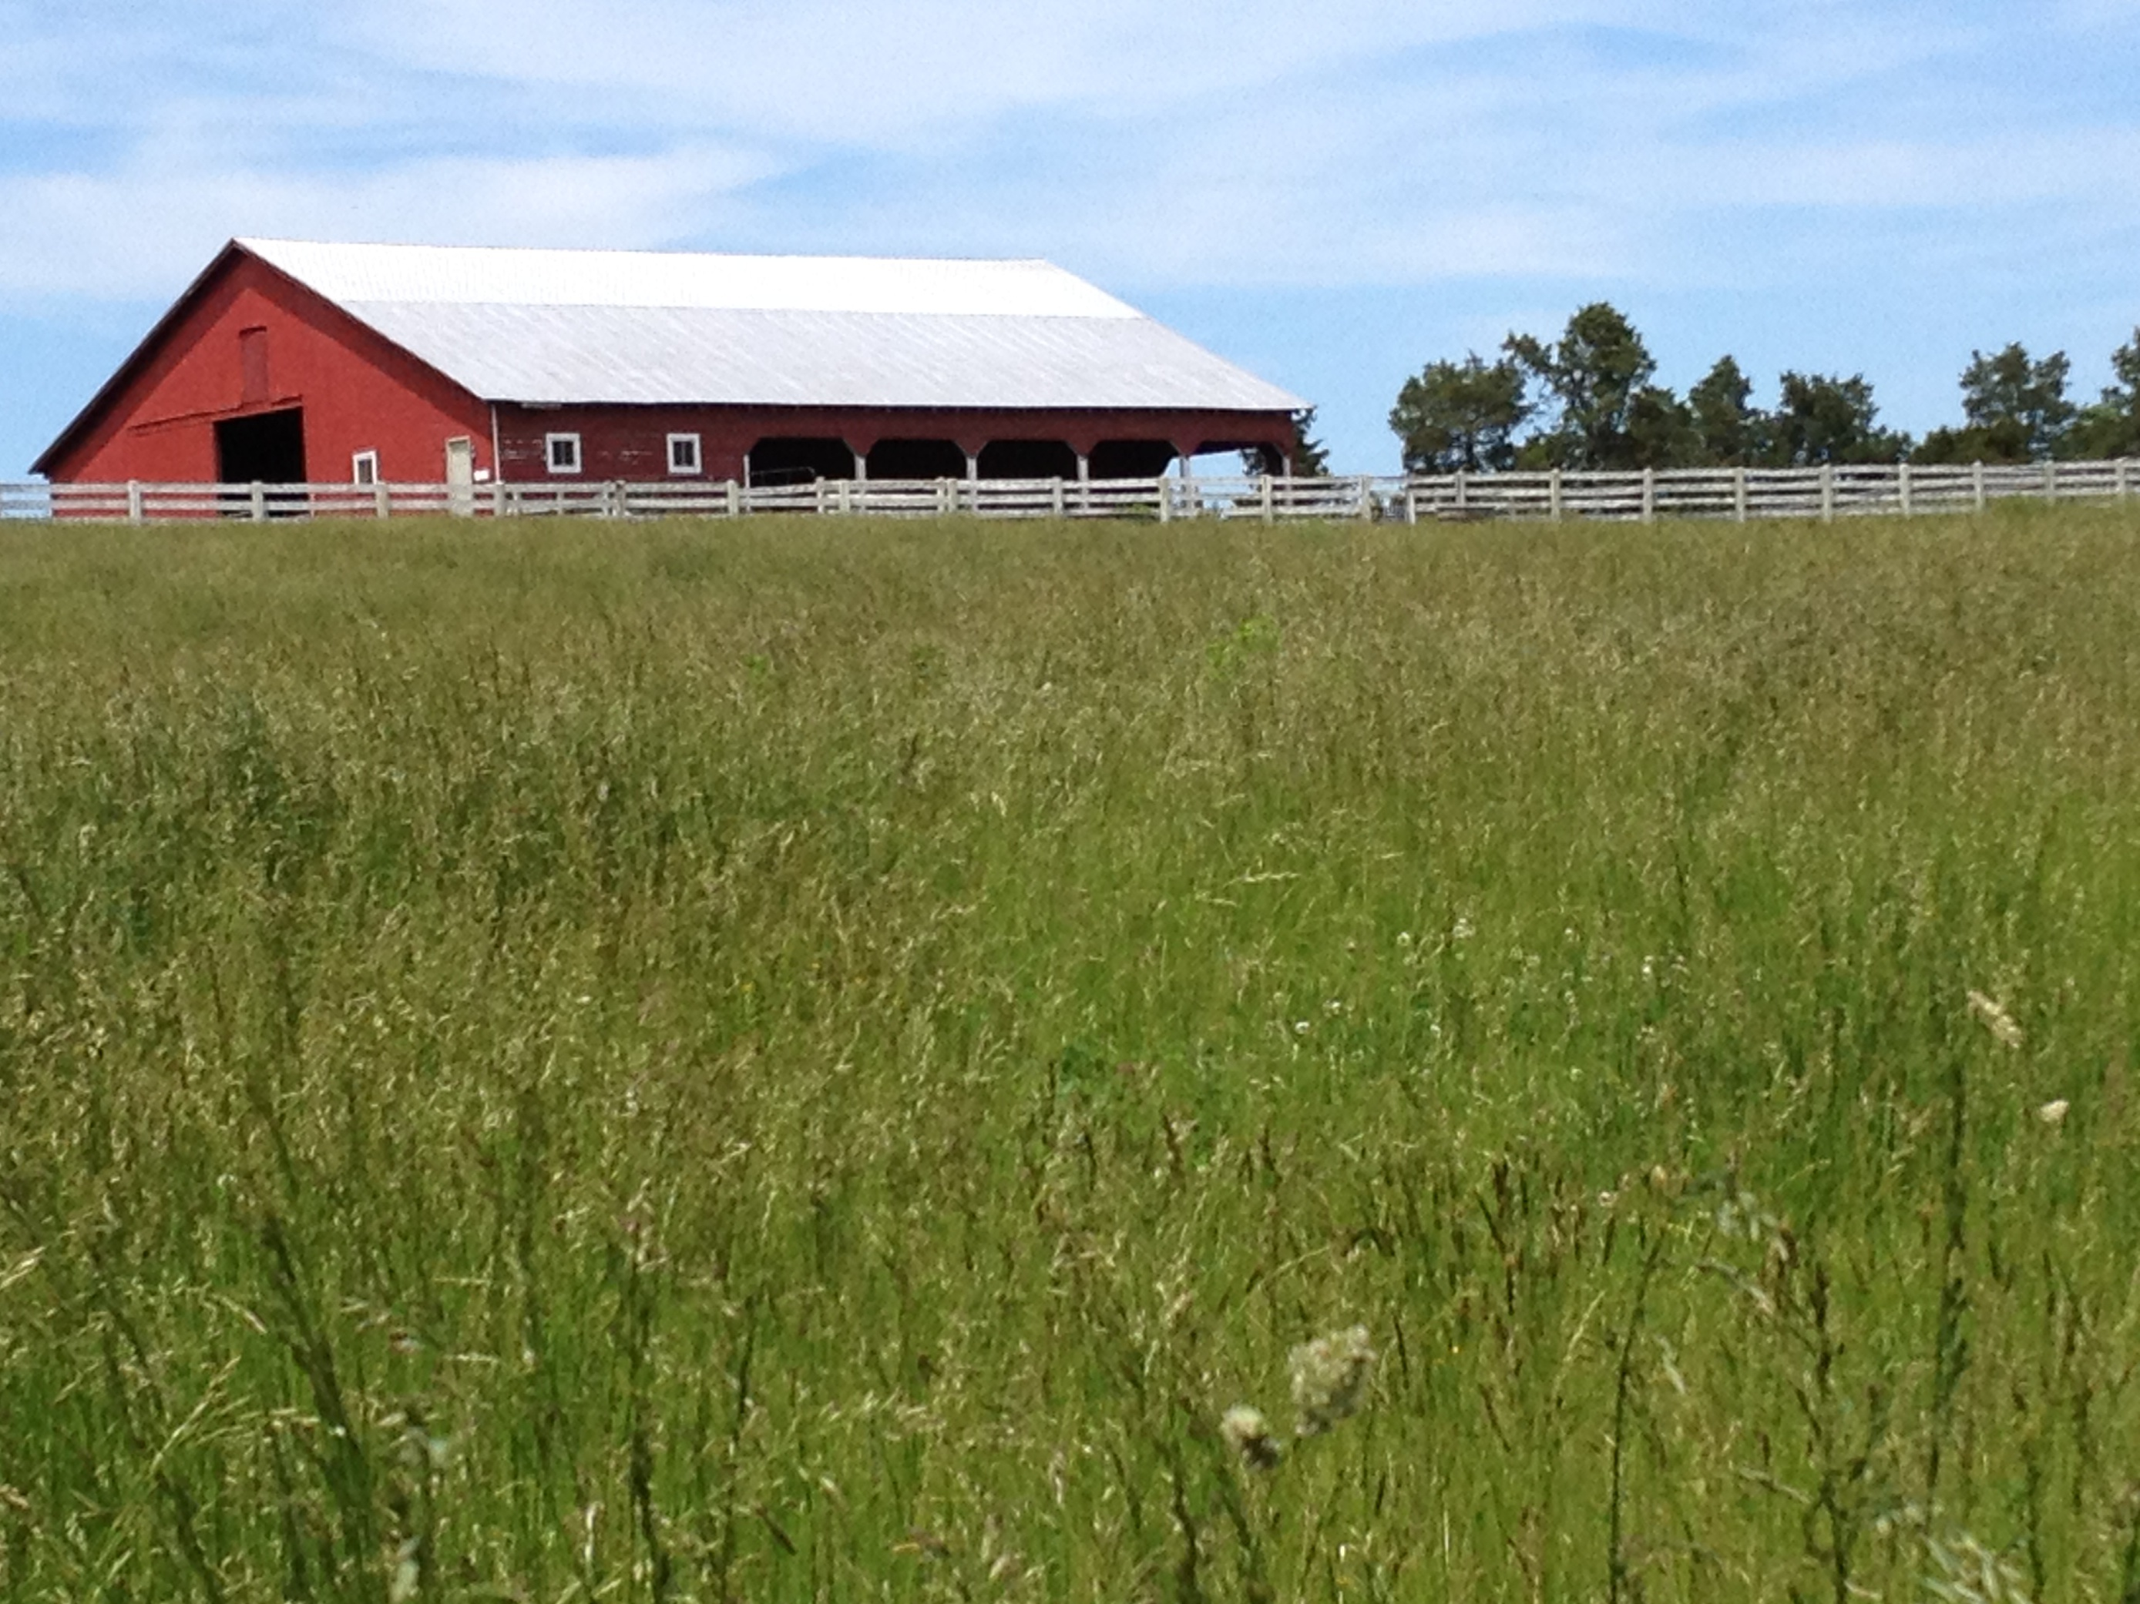
Why is it important to be efficient and conserve water?
While we are very fortunate to have Buffalo Bill Reservoir, it is always good practice to conserve water when ever you can.
Make sure if you are using an open ditch to have canvas in your end check or a good dam at the end of your set. If you are using gated pipe, make sure that you have good gates that seal and have good O-rings in the bells of the gated pipe joints
As drought conditions in the West persist, we must be diligent in our efforts so that we can keep using our valuable resources.

Slide 12

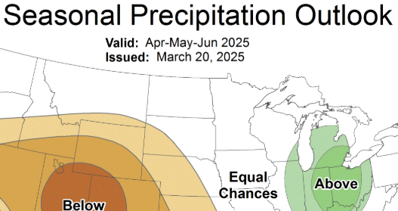
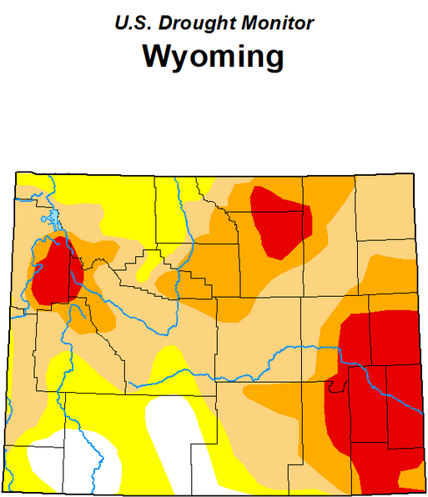
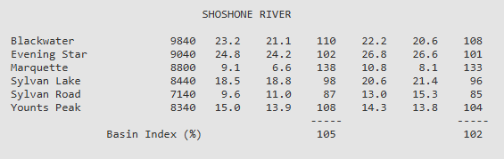
Water and Precipitation outlook

